Slide 1
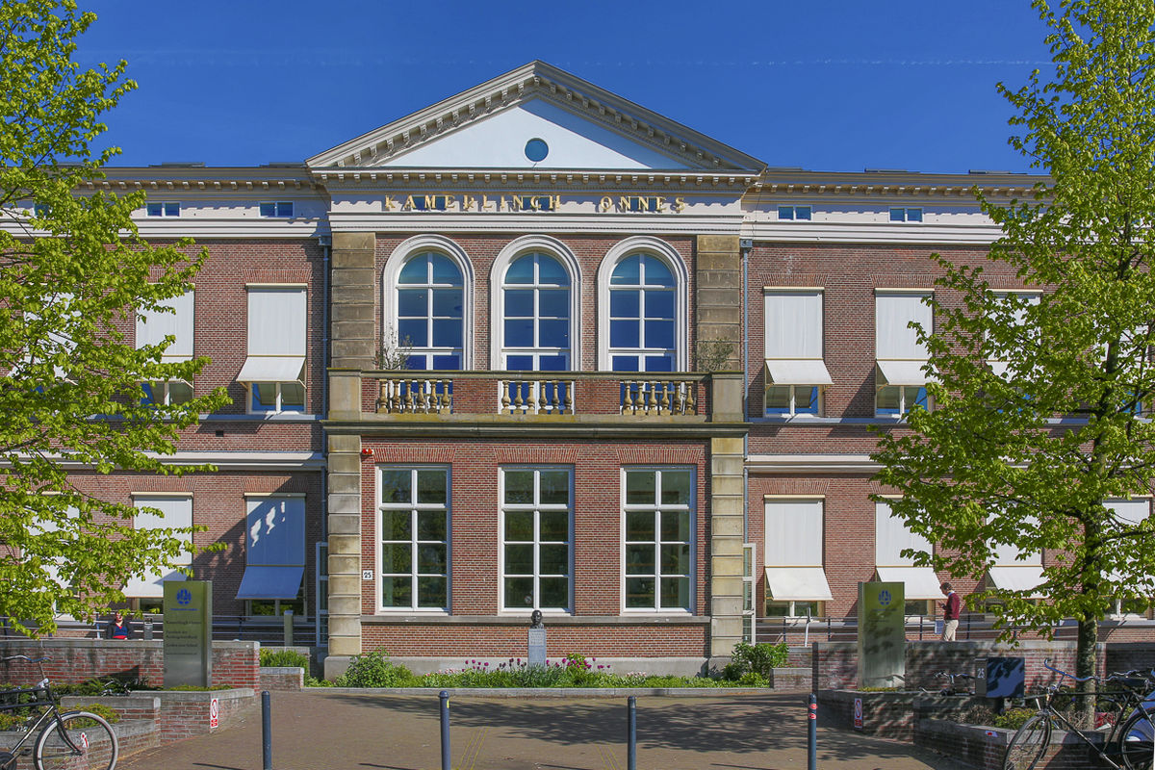
International Children’s Rights
Reflections on Children, Family and the Role of Courts
Prof. Dr. Ton Liefaard | Ulaanbaatar, 25 June 2025

Slide 2
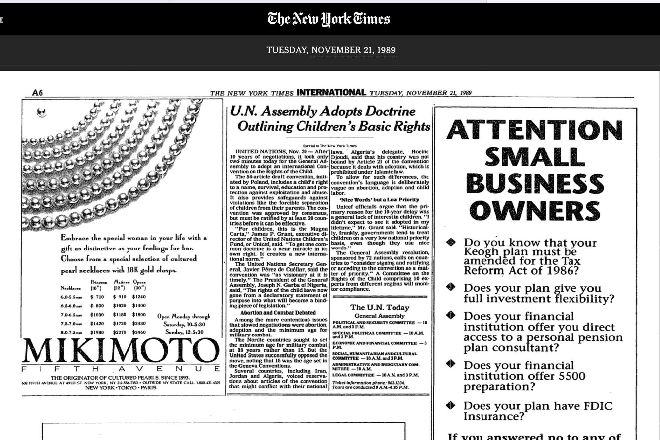
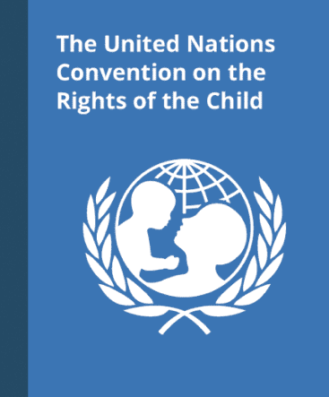
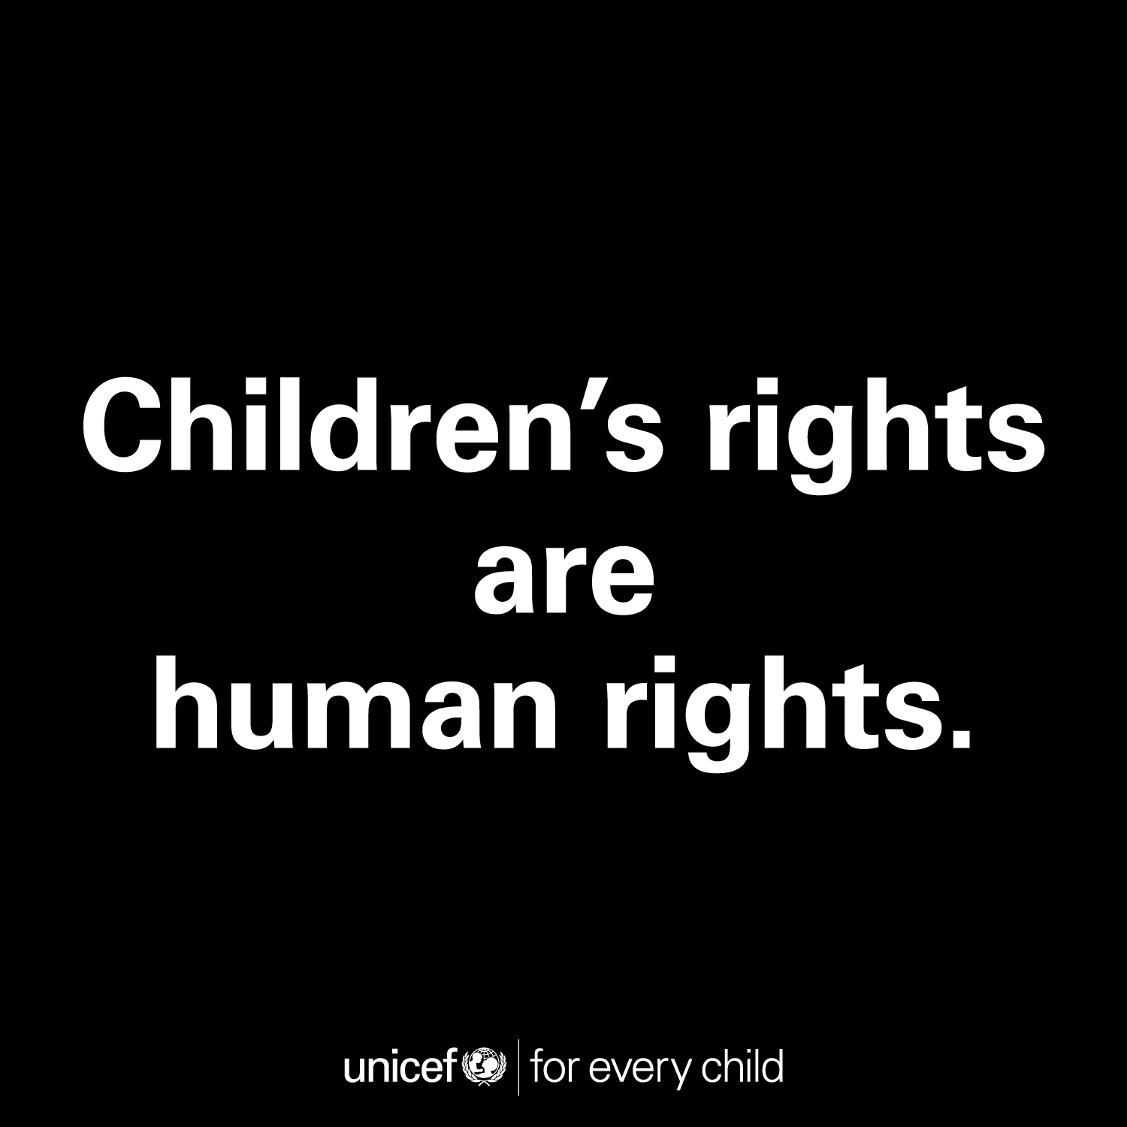
November 1989
Notes:
Please allow me to take you back to november 1989…

Slide 3

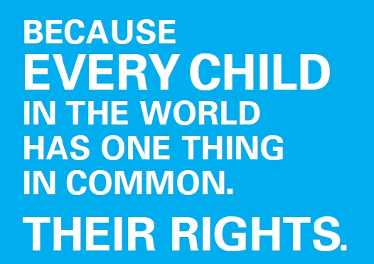
‘Universal Narrative’
Notes:
Meaningful? Yes, because it provides a common language, narrative
However, as such added value should not be overestimated – lipservice, reservations, wishful thinking?
Today’s lecture will be about:
This foundations of children’s rights – emergence, key messages and core values
The achievements during the first 35 years – impact
Foreward looking perspective – how to protect children’s rights in the next 35 years? There are some dark clouds gathering together over children’s rights…

Slide 4
UN Convention on the Rights of the Child (CRC) – Game Changer
Human rights treaty for children + three Optional Protocols
Child (art. 1 CRC: < 18 years of age):
  Rights holder
  Human being in development with special needs
  Member of his (extended) family
Anno 2025 – Comprehensive, multilayered,
dynamic, complex and relatively young field of law
Room for diversity – open norms
Higher degree of protection needed? – instructive norms
Notes:
4
Special: one of the treaties for special groups of human beings – women, migrant workers, peope with disabilities, indigenous peoples, children
Comprehensive: it contains both civil and political rights, as well as economic, social and cultural rights.
Legal impact
1. It has confirmed norms
2. It has created new or clearer norms
3. It has stimulated the inclusion of children in law and legal systems

Slide 5
Core values of international children’s rights
Best interests of the child play a pivotal role
  in connection with the rights of the child and bearing in mind the child’s evolving capacities
Respect for human dignity of the child – equivalence
All children matter – non-discrimination & inclusion
Children as citizens – participation,
& access to justice
© Photo : Gaby Herbstein / Council of Europe 2019
Notes:
Wat zijn die kernwaarden van het kinderrechtenverdrag?
Comprehensive approach to children
Beyond vulnerability
Beyond protection
Embracing agency
Acknowleding growing autonomy
Empowering rather than belittleing
Children at the heart of our society
CHILDREN’S RIGHTS GET THEIR MEANING IN SPECIFIC CONTEXT.

Slide 6
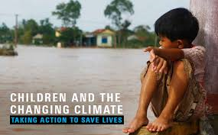
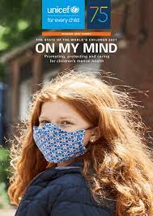
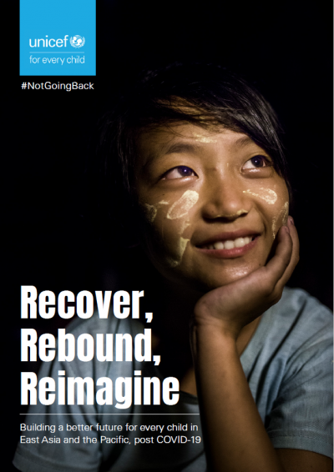
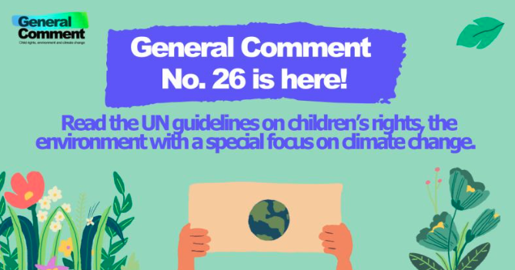
UN CRC as a ‘living instrument’
Notes:
Meegroeien met zijn tijd, maar vasthouden aan kernwaarden
New frontiers!!
Summit for the future!!

Slide 7
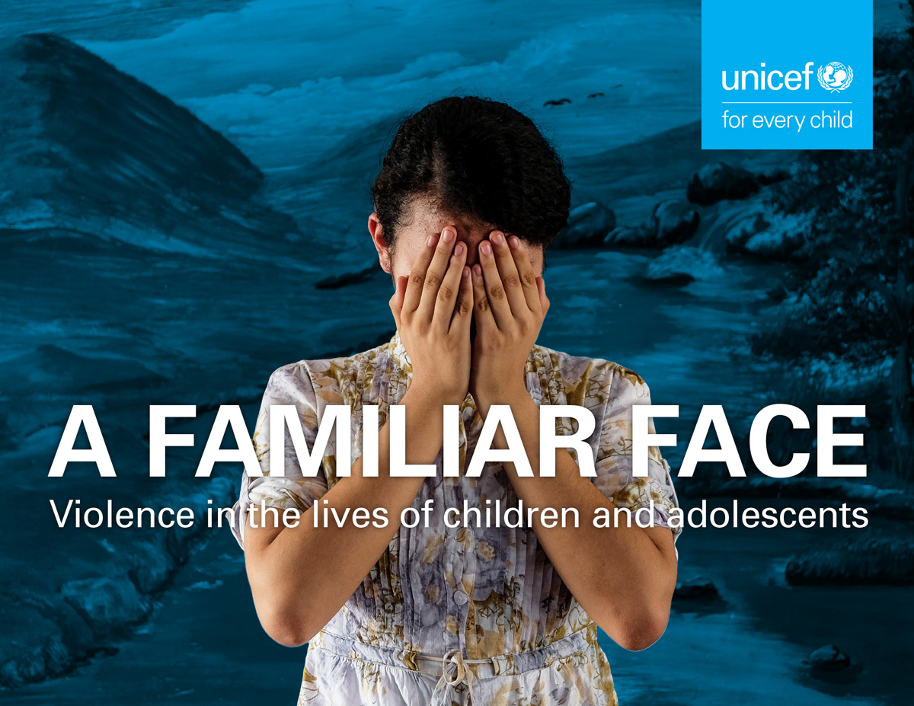
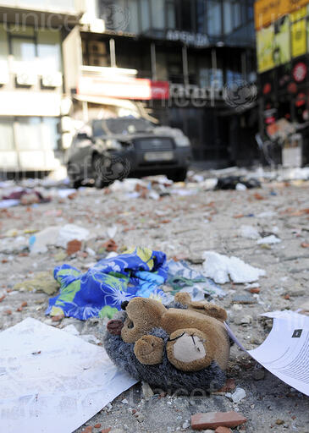
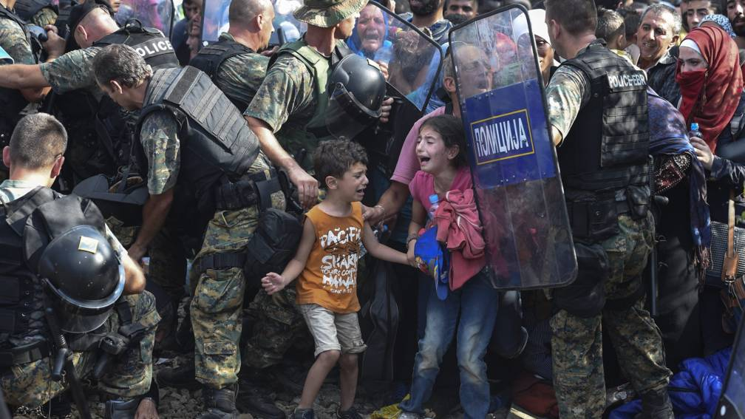
35th Anniversary of the UN CRC
Progress since 1989 &
living instrument
‘Polycrisis’ – UNICEF 2023
Regression and push backs – Skelton 2024
‘Justice gap’
  Lack of recognition of children as rights holders
  Lack of equivalence of children
  Exclusion & discrimination -> lack of participation
  Lack of accountability
Photos: UNICEF & TdH
Notes:
The pandemic’s harms will continue to be counted — but reforms of health architecture and medical breakthroughs offer hope for children.
Efforts to tame inflation will have unintended negative effects on child poverty and well-being — requiring policy measures that protect investments for vulnerable families and children.
Multiple factors will contribute to continued food and nutrition insecurity — with increasing calls for greater climate adaptation and food systems reform to prevent food poverty in children.
The worsening energy crisis may cause immediate harm to children — but the focus on energy sustainability provides hope for a greener future.
Unmet needs and underinvestment in children warrant reforms of financial flows to developing countries — while renewed attention on climate finance and debt relief holds promise.
Threats to democratic rights such as freedom of expression are expected to continue— but social movements, including those led by young people and women, are likely to push back.
Increasing factionalism will put further stress on multilateralism — but efforts to address children’s and young people’s concerns may offer opportunities to find common ground.
The internet will continue to fragment and become less global, resulting in further disparities for children — prompting a greater push for openness, fairness and inclusion.
SKELTON: WAR, ENVIRONMENTAL DEGRADATION & CLIMATE CHANGE, POVERTY & INEQUALITY (333 MILLION LIVE IN EXTREME POVERTY, 1 IN 6 ACCORDING TO WORLD BANK), DISPLACEMENT (43,3 CHILDREN ARE FORCIBLY DISPLACED, UNICEF 2023) - >
WITHIN UN PUSHBACKS ON CHILDREN’S RIGHTS NARRATIVE – PARENTAL RIGHTS, FAMILY VALUES & SANCTITY OF THE FAMILY -> NEW COALITIONS AROUND CONSERVATIVE AGENDAS ERODING CHILDRENS RIGHTS.
MOREOVER: SHRINKING SPACE FOR CIVIL SOCIETIES, AUTHORITARIAN REGIMES / ILLIBERAL DEMOCRACIES UNDERMINING THE RULE OF LAW AND INNDEPENDENCE OF THE JUDICIARY.
At the level of children: ‘justice gap’ -> ‘systemic failures in holding governments and institutions accountable for violations of children’s rights’ (Center on International Cooperation, 2019)
Access to equitable justice – vehicle to demand rights and to narrowing the justice gap and the lack of accountability.

Slide 8
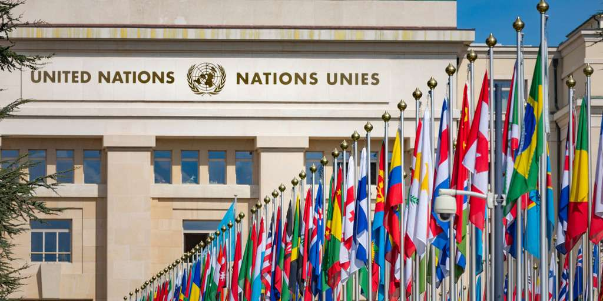
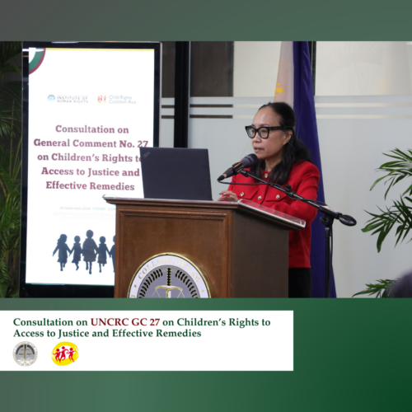
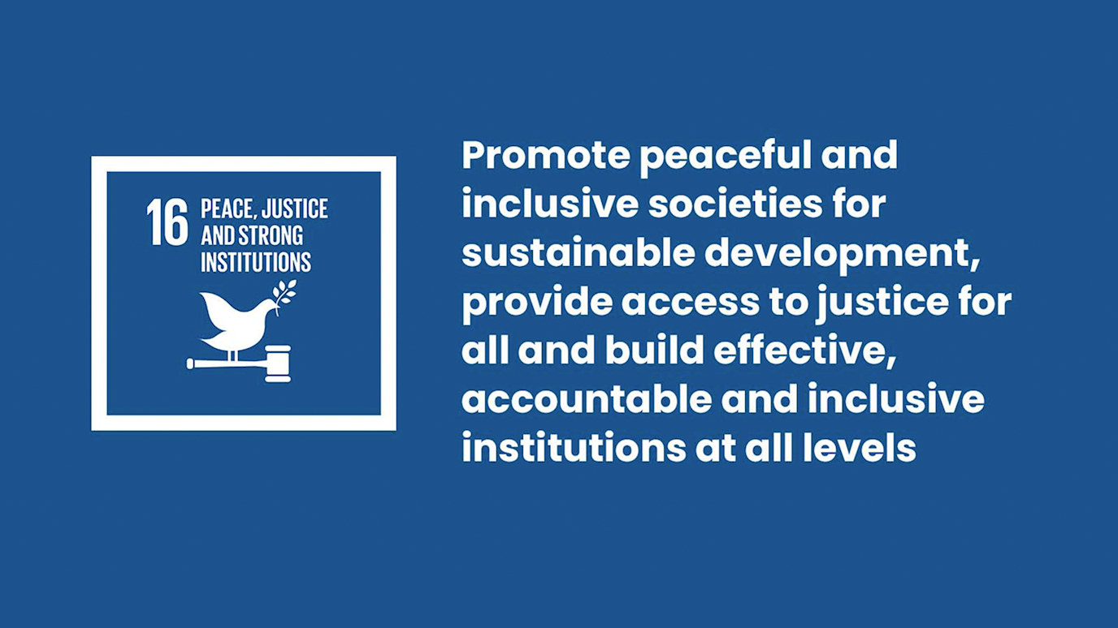
Reflection 1 – Accountability & access to justice for children
Notes:
Accountability …
In the context of children’s rights, accountability refers to the obligation of governments, institutions, and other duty-bearers (OHCHR and Centre for Economic and Social Rights, 2013; Sedletzki, 2017) to fulfill their responsibilities to protect, promote, and respect the rights of children as outlined in the CRC. This means establishing mechanisms to address violations, providing remedies, and implementing systemic changes to prevent future breaches. Moreover, accountability encompasses transparency and responsiveness, ensuring that institutions demonstrate how they are meeting their obligations and actively involve children in processes that affect their lives (UNICEF,2015).
Accountability is essential to bridging the justice gap as it empowers children and their advocates to demand fair treatment, uphold their rights, and foster trust in institutions. It requires not only that violations are addressed when they occur but also that there are proactive measures in place (Center on International Cooperation, 2019).
In relation to this we need to explore the concept of social accountability, which essentially revolves around the relationship between children and those in power. The quality of that relationship can define to what extent a child feels respected and can find justice.

Slide 9
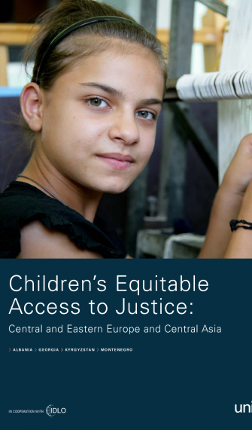
Making rights a reality: effective remedies
‘for rights to have meaning, effective remedies must be available to redress violations’
UN Committee on the Rights of the Child, GC No. 5, para 24
‘rights without remedies are of symbolic importance no more’
Michael Freeman (2007)
Access to justice: ‘the ability to obtain a just and timely remedy for violations of rights as put forth in national and international norms and standards, including the [CRC]’
UN High Commissioner for Human Rights (2013) / Human Rights Council (2014)
Notes:
The High Commissioner observed that access to justice ‘is a fundamental right in itself and an essential prerequisite for the protection and promotion of all other human rights’.

Slide 10
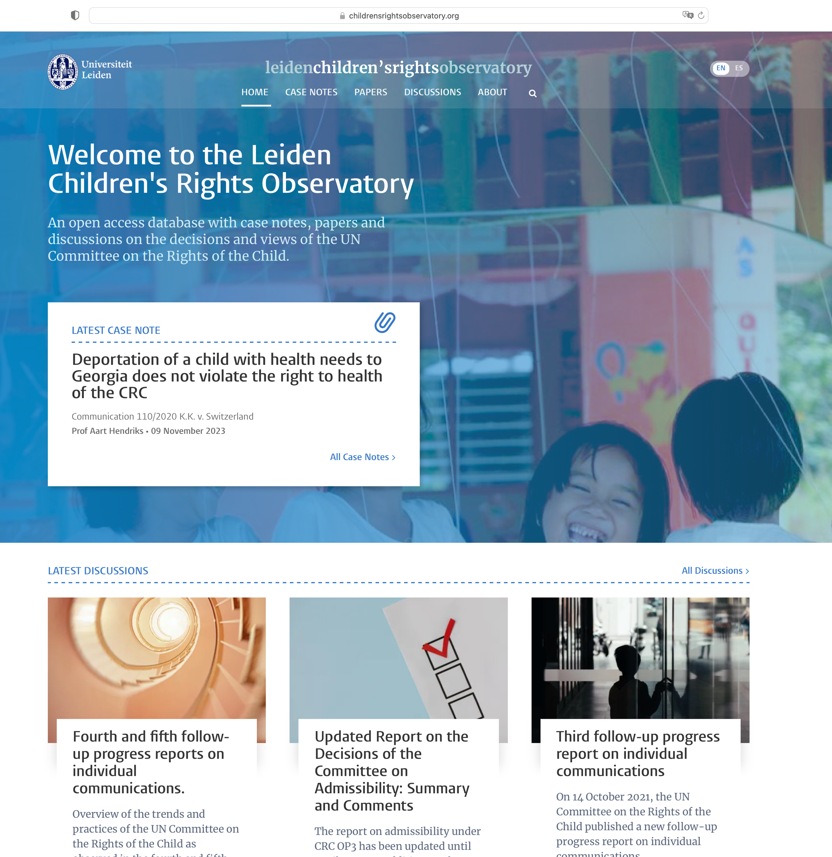
International access to justice for children
Optional Protocol to the CRC on a communications procedure (OPIC)
‘Recognition of access to justice for children’
10th Anniversary of OPIC in April 2024
  Growing number of states (53)
  Case law is developing fast
  Complex and sensitive cases
  Individual and general/systemic remedies
  Growing body of knowledge around access to justice
Notes:
Een klein uitstapje….
Real meaning at the domestic level?
OPIC as a vehicle to promote access to justice at the
domestic level

Slide 11
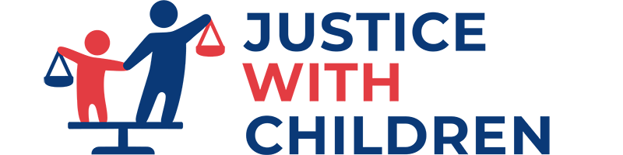
Reflection 2
Global Initiative on Justice With Children – justicewithchildren.org
Notes:
Alle kinderen en samen met kinderen.
Specifieke groepen
Verwachtingen
Hoe willen kinderen het recht kunnen gebruiken?
Wat zouden effectieve beschermingsstrategieen zijn?

Slide 12
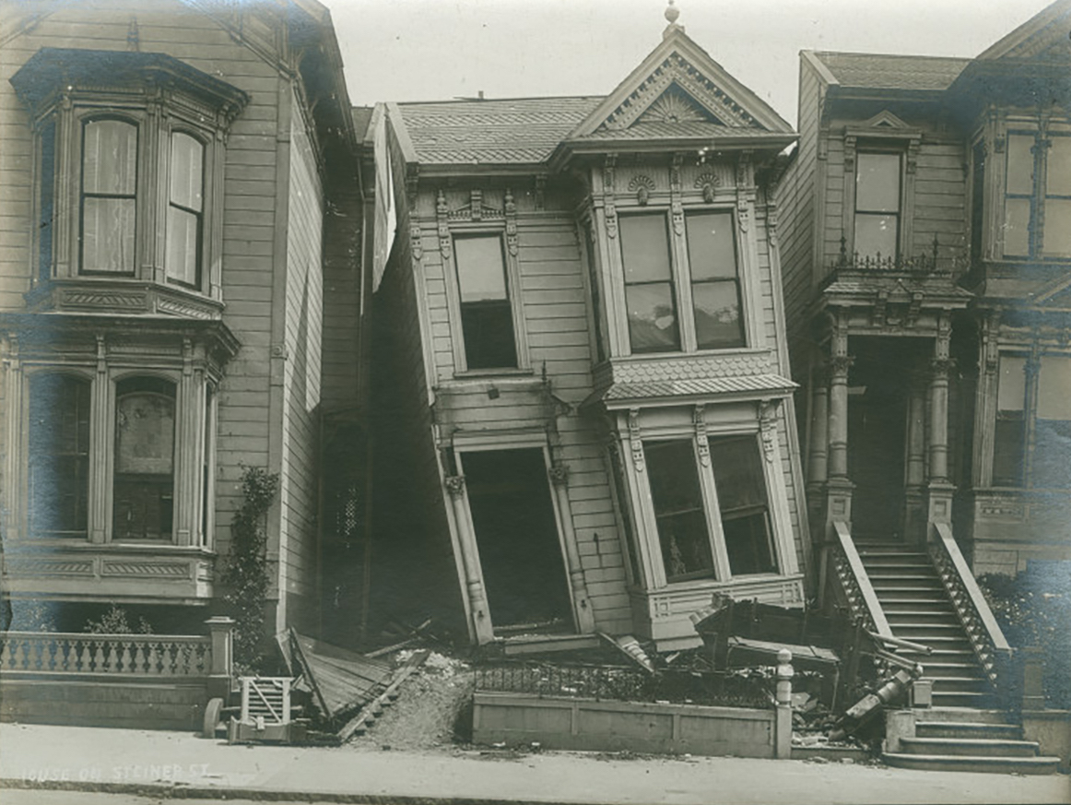
Reflection 3 – Children’s rights as foundation
Notes:
Er moet een sterker fundament komen voor kinderrechten – anders gaat het huis van het recht inzakken en dan ziet de rechtsbescherming er over een tijdje zo uit.
Tegelijkertijd kunnen kinderrechten

Slide 13
Justice Albie Sachs, 6 December 2018
(with reference to Justice Sandile Ngcobo)
‘In a constitutional state the hands of justice are never tied.’
Notes:
RECHTERS SPELEN EEN CRUCIALE ROL IN HET WAARBORGEN VAN KINDERRECHTEN EN WAT MIJ BETREFT IN HET VERDUURZAMEN VAN KINDERRECHTEN.
Uiteindelijk is de rechter de enige autoriteit die tegenwicht kan bieden, een knoop door te hakken in zaken die op scherp staan, te controversieel zijn. Rechters kunnen ons de wegwijzen als we even het spoor bijster zijn. Als problemen te complex zijn geworden en we er met het poldermodel niet uitkomen. En voor individueel kind, met zijn of haar eigen verhaal, die klem zit, uit beeld is geraakt, gevaar loopt, is de rechter de beslisser die hem of haar serieus kan nemen; die het kind zien, ernaar kan luisteren en die duidelijk maakt dat niet het kind maar de rechter verantwoordelijk is voor het doorhakken van het kind.
Het is interessant om te zien dat rechters de laatste tijd in controversiele kwesties de verantwoordelijkheid om een beslissing te nemen, en daar niet voor wegduikt omdat het de overheid en wellicht ook ons allemaal onder druk zet. Denk aan urgenda, denk aan stikstof, denk ook aan de kinderen in IS-gebied.
Maar we kunnen het ook hebben over de rechters die op dagelijkse basis nadenken over complexe belangenafweging in het familierecht, in het strafrecht en het vreemdelingenrecht
En over de rechters die hun nek uitsteken om uitspraken in kindvriendelijke taal op te schrijven.
En tot slot heb ik het ook over iemand als Jolande Calkoen.
Jolande: toen ik begon was jij allang bezig – nu neem jij afscheid en is het aan ons om door te gaan – dank voor jouw inspirerende leiderschap, hier en in Europa. Ik weet hoe wezenlijk jouw werk daar was, al ziet niet iedereen in Nederland dat zonder meer.
En vandaag geef je het stokje over. Mijn oproep aan een ieder hier is om door te gaan op het pad waarop jij ons bent voorgegaan. Kinderen hebben rechters nodig; rechters die zich durven uitspreken; kinderrechten zijn niet vrijblijvend; kinderrechten geven toegang tot het recht; dat kan alleen maar van betekenis zijn als zij daar iemand ontmoeten die voor hen durft te gaan staan, hoe moeilijk en complex ook; die zakelijk afweegt, en zakelijk invulling geeft aan met kinderrechten samenhangende verantwoordelijkheden en een luisterend oor biedt en bereid is om zich open te stellen voor het kind. U speelt daarbij een cruciale rol.
En dat komt bij elkaar in dit citaat dat ik vorig jaar hoorde in Zuid-Afrika. Ik dank u hartelijk voor uw aandacht.
Justice Albie Sachs (in S v. M, 2007, SA Constitutional Court):
‘If a child is to be constitutionally imagined as an individual with a distinctive personality, and not merely as a miniature adult waiting to reach full size, he or she cannot be treated as a mere extension of his or her parents, umbilically destined to sink or swim with them’.
Justice Peter Jackson (UK Supreme Court, 13 juli 2017)
‘Dear Sam, …’

Slide 14
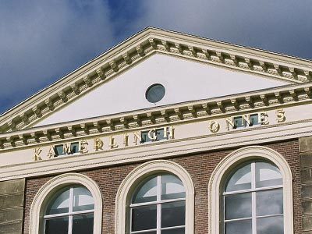
Thank you very much!
Prof. Dr. Ton Liefaard
UNICEF Chair in Children’s Rights
Head of Department of Child Law and Health Law
Leiden Law School
E-mail: t.liefaard@law.leidenuniv.nl

Slide 15
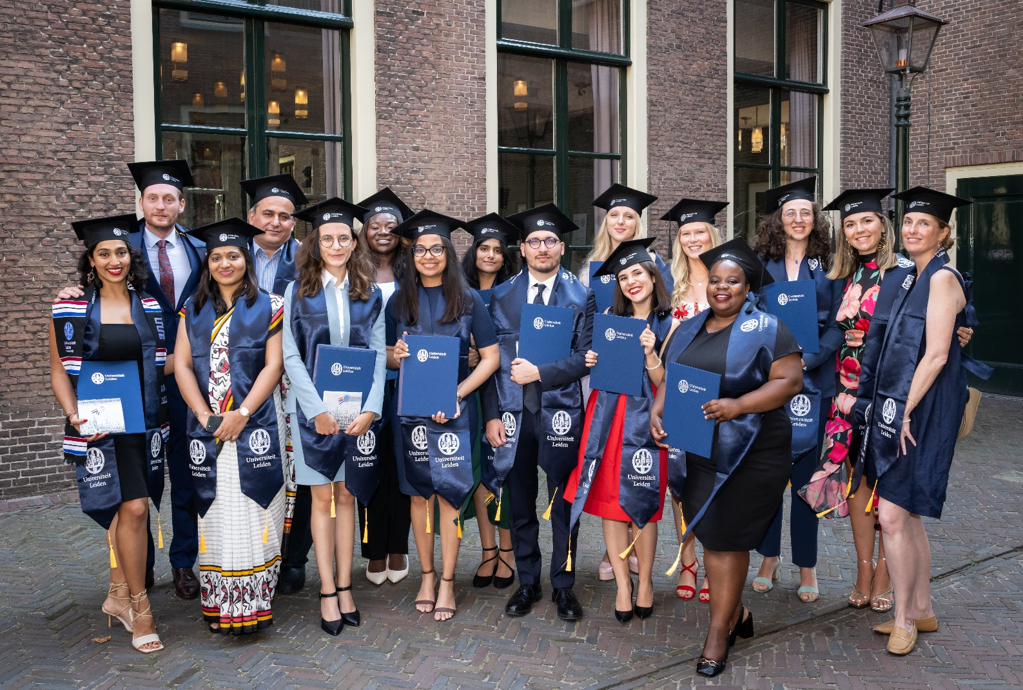
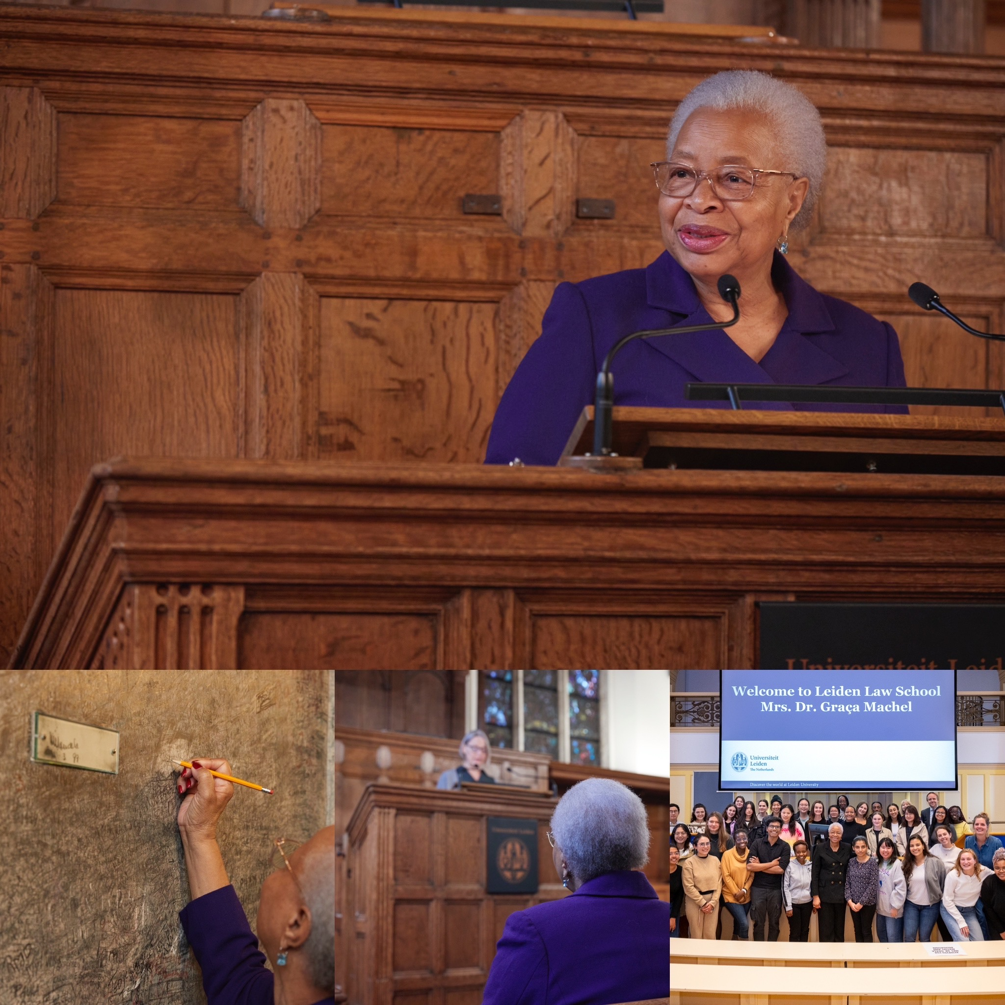

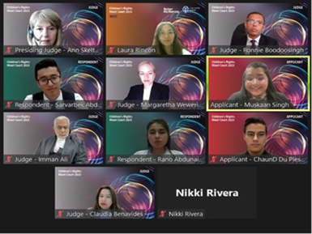
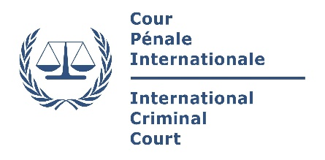

Children’s Rights @ Leiden University

Slide 16
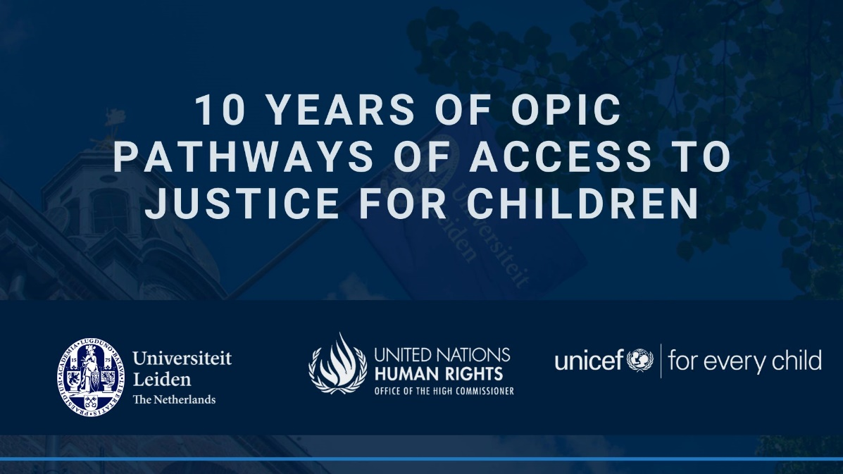
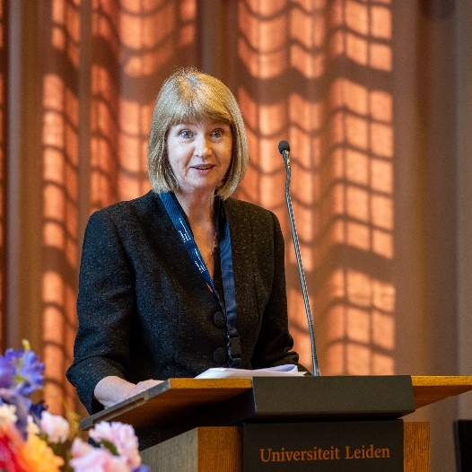
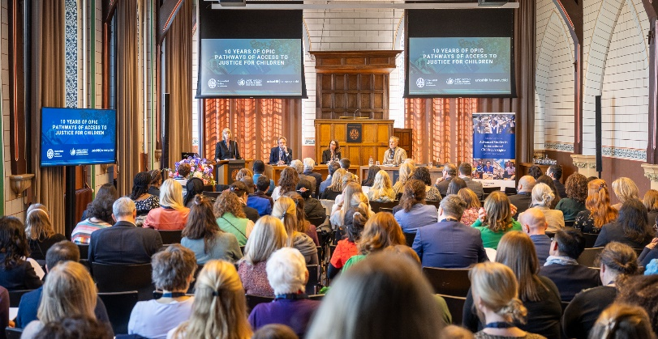
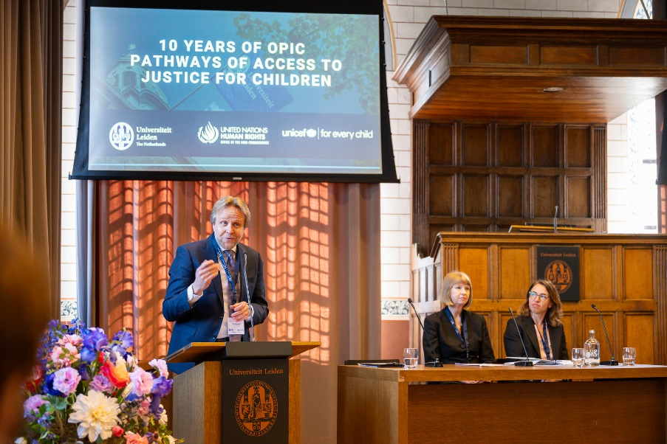
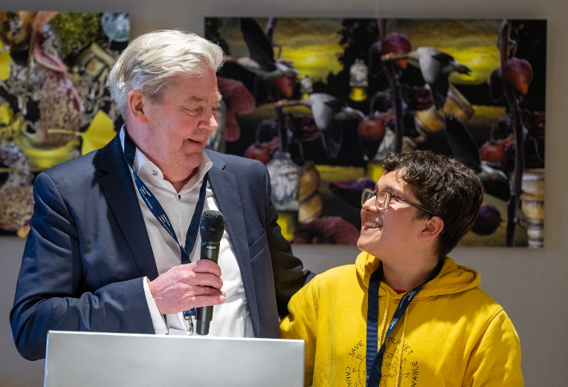
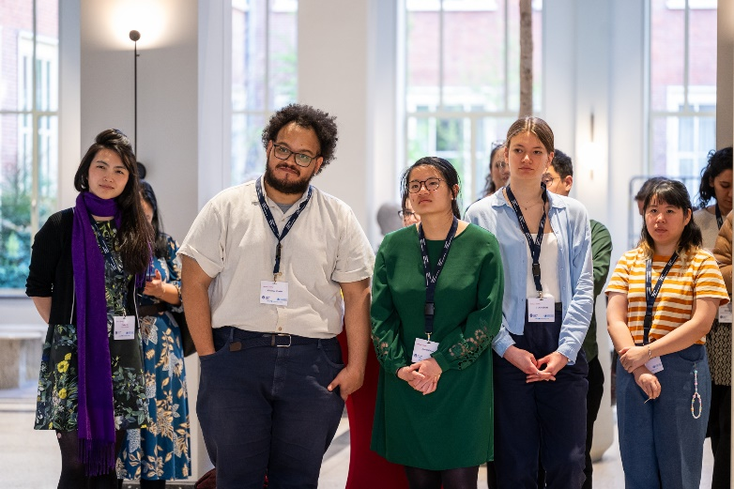
10 years delivering justice to children – April 2024

Slide 17
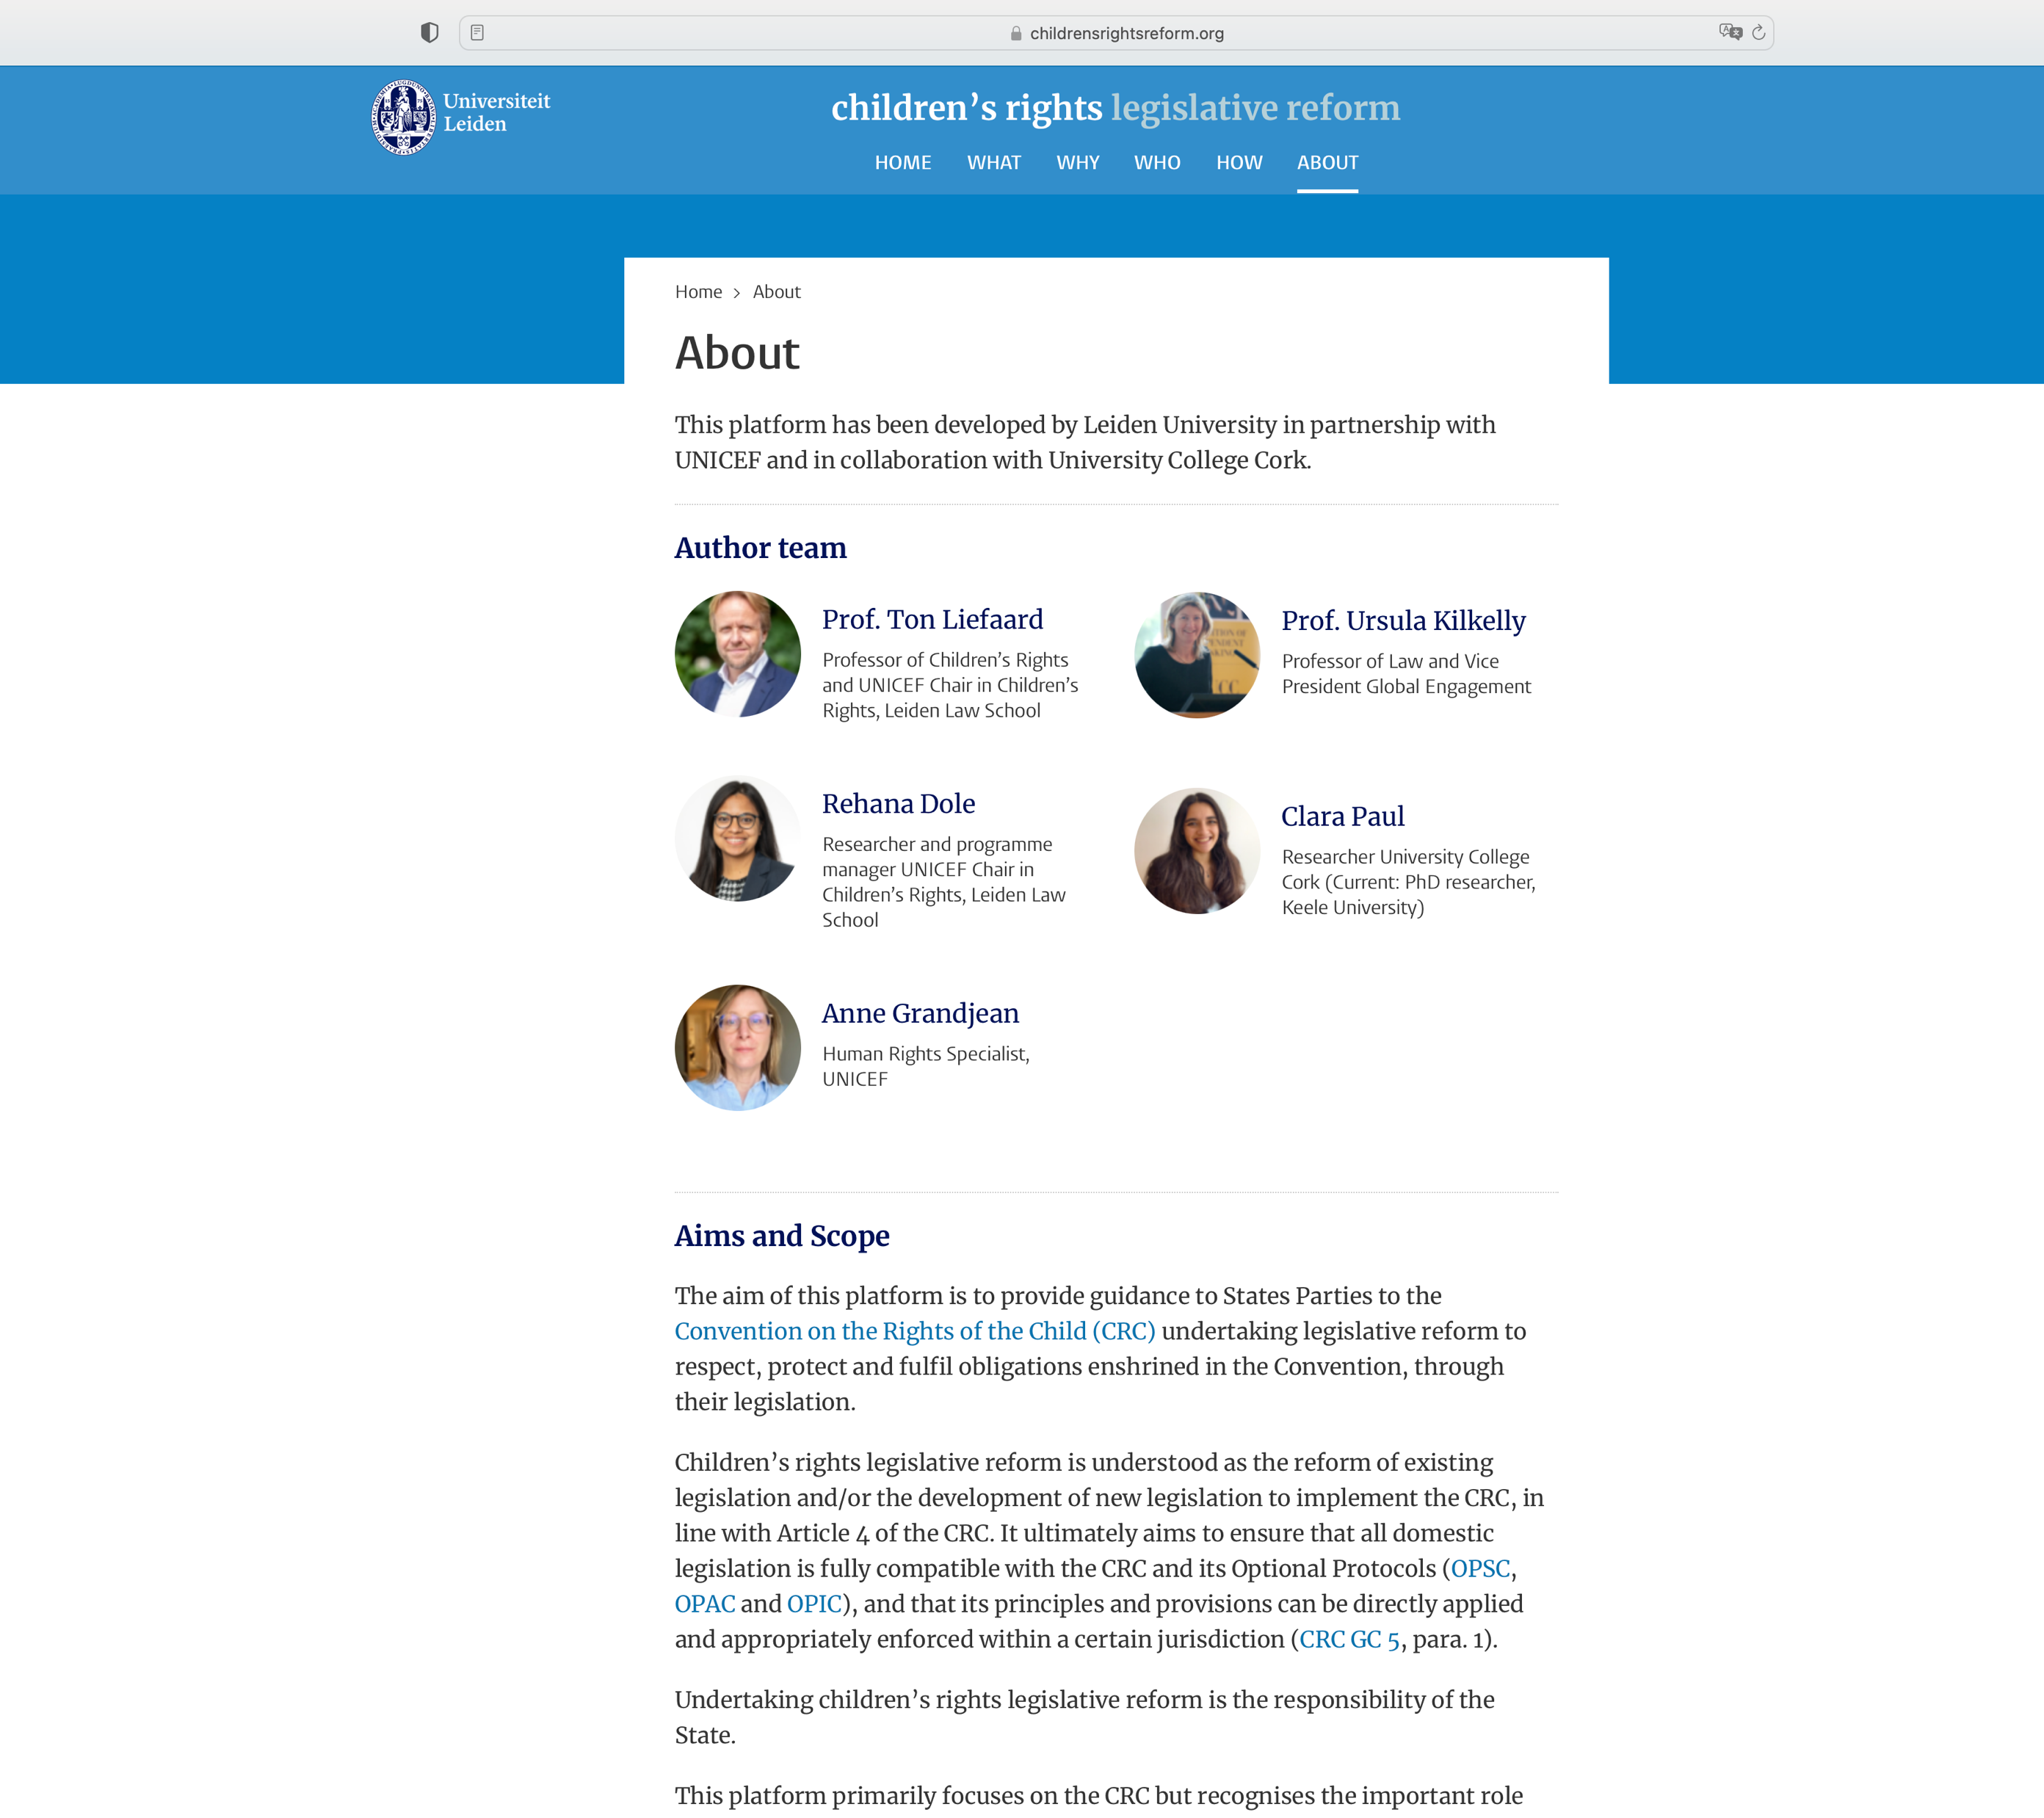
Leiden Children’s Rights Observatory
&
Children’s Rights Legislative Reform

Slide 18
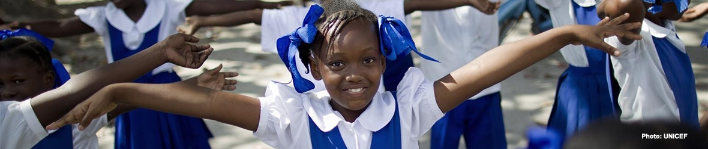

Title clos
Child Rights Education Leiden Law School
Advanced Master / regular master
Master of Laws (LL.M): Advanced Studies in International Children’s Rights
(Dutch) Child law - regular master program (in Dutch)
Bachelor level
Introduction to International Children’s Rights (in English)
Introduction to Dutch child law (in Dutch)
Legal Aspects of Child Abuse (in Dutch; part of interdisciplinary minor on child abuse)
Summer School Programme ‘Frontiers of Children’s Rights’
July 2025 – Leiden / The Hague – 11th edition
Post-graduate education & training
Child law & international children’s rights
Children’s Rights Moot Court 2025

Slide 19
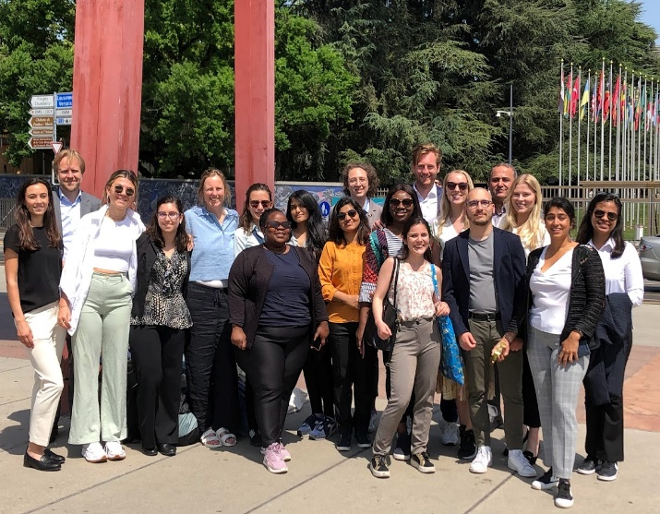
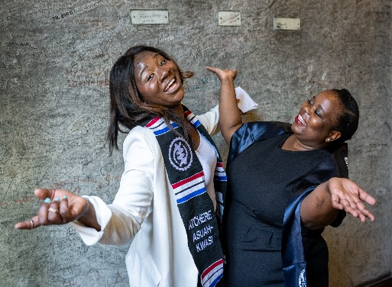
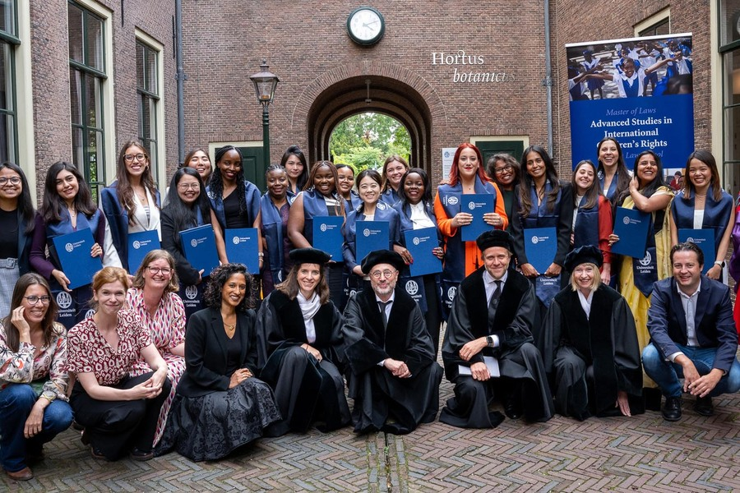
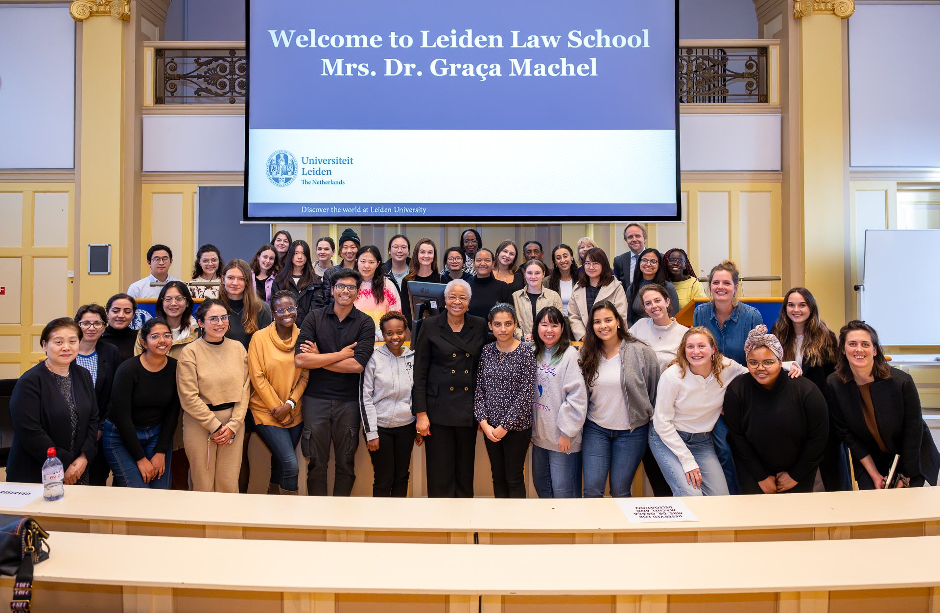
LL.M. Advanced Studies in International Children’s Rights
19

