Slide 1
Juvenile Criminal Law in Germany
Ulaanbaatar, 2025-06-25 - Senior Public prosecutor Stephan Schäl

Slide 2
Speaker
Who is speaking:
    Stephan Schäl
    Deputy Chief Public Prosecutor
    Office of the Public Prosecutor General in Bamberg
    Bavarian Central Office for the Prosecution of Cybercrime
    Germany
    Before: Judge at the local court in Bamberg, Germany.
    Responsible for family law and juvenile law

Slide 3
Juvenile criminal law in Germany
Definitions in Germany:
    Children (Kinder): Persons under the age of 14;
    Juvenile (Jugendliche): Persons who have already reached the age of 14 but are still under 18 years of age;
    •Adolescents (Heranwachsende): Persons who are already 18 years old but not yet 21 years old;
    Adults (Erwachsene): Persons over 21 years of age.

Slide 4
Juvenile criminal law in Germany
Reasons for a special juvenile criminal law:
    Young people are in a transitional phase between childhood and adulthood;
    A procedure adapted to the developmental stage of the perpetrator is necessary to determine:
    the motives for the offence and
    to identify deficits in their education and upbringing

Slide 5
Juvenile criminal law in Germany
Reasons for a special juvenile criminal law:
    Young offenders often do not act on their own initiative, as they are influenced by others;
    The focus should not be on punishment, but on education;
    Special law in Germany “Jugendgerichtsgesetz” (JGG).

Slide 6
Juvenile criminal law in Germany
    Juvenile criminal law applies:
    Children under 14 are not subject to criminal responsibility.
    Only juvenile welfare and civil law can be applied.
    (Relevant is always the time of committing the offence, not the age at the court trial)

Slide 7
Juvenile criminal law in Germany
    Juvenile criminal law applies:
    Always to juveniles (age 14-18);
    but “relative” criminal responsibility law only applicable, if the juvenile according to his physical and psychological development is able to recognize the wrongdoing of the criminal act and is able to act according to this cognitive discernment.

Slide 8
Juvenile criminal law in Germany
    Young adults / Adulescents (age 18-21)
    Absolute criminal responsibility
    Juvenile criminal code applies, if :
    either delayed in their development and should still be treated as juveniles;
    or typical juvenile offence.
    Otherwise treated as adults, Criminal Law for Adults will apply.

Slide 9
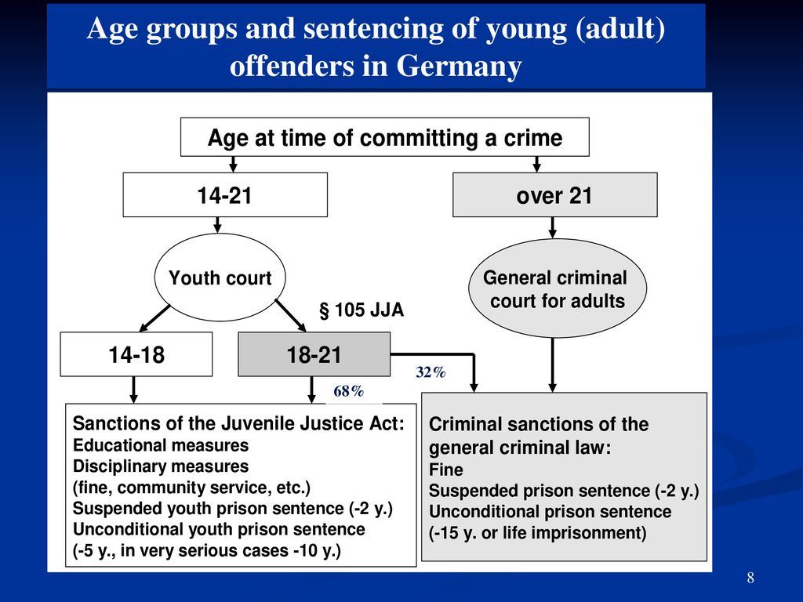
Juvenile criminal law in Germany

Slide 10
Juvenile criminal law in Germany
    Possible sentences in juvenile criminal law:
    1. Disciplinary measures:
    e.g. instructions to perform community serving hours;
    attend an educational / social training course;
    ban on alcohol or drug consumption with mandatory urine tests;
    apologies to the injured person;
    to pay a sum of money to a charity organization;
    repair the damage, e.g. clean a dirty wall.

Slide 11
Juvenile criminal law in Germany
    Possible sentences in juvenile criminal law:
    2. Juvenile Detention (1 day up to 4 weeks in a special juvenile prison)
    Often in combination with disciplinary measures

Slide 12
Juvenile criminal law in Germany
    Possible sentences in juvenile criminal law:
    3. Prison Sentence, often suspended on probation
    Only if:
    No milder punishment is sufficient to prevent the young person from committing further offences (malicious tendencies) or
    if the weight of the crime requires a prion sentence.
    Length: at least 6 month up to 10 years

Slide 13
Juvenile criminal law in Germany
    Approbation:
    Prison sentence not more than 2 years;
    Positive prognosis, that he will not reoffend;
    Instructions are laid down which the convicted person must follow;
    Help via a probation officer;
    After a period of 3 years: sentence will be waived;
    If instructions are not followed: Perpetrator will be brought to jail.

Slide 14
Juvenile criminal law in Germany
    Parties involved in juvenile criminal proceeding:
    Judge;
    Special Prosecutor;
    Juvenile court assistance from youth welfare office;
    Perpetrator;
    Parents or legal guardian;
    In higher crimes: defense lawyer.

Slide 15
Juvenile criminal law in Germany
Objectives of German juvenile criminal law:
    Young offenders often do not act on their own initiative, as they are influenced by others.
    The focus should not be on punishment, but on education.

Slide 16

Many Thanks for the attention !
Questions ?
Contact:
Stephan Schäl
Deputy Chief Public Prosecutor
Email: Stephan.Schael@gensta-ba.bayern.de

