Slide 1
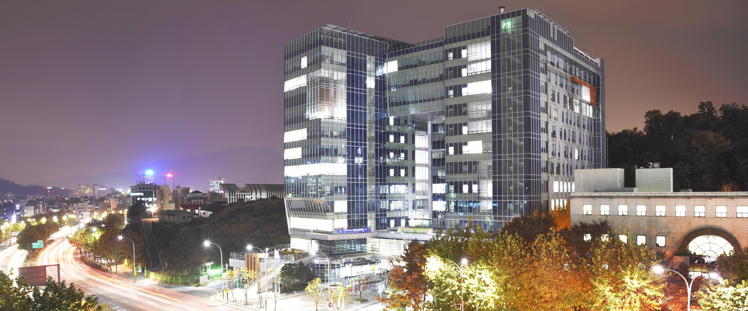
﻿The History and Recent Trends of the Family Court in Korea
Hyoung-ryul, KIM﻿
Presiding Judge, Seoul Family Court

Slide 2
특례법 입법 경위와 목적
﻿1. Initial Establishment

Slide 3
특례법 입법 경위와 목적
﻿On October 1, 1963, the Seoul Family Court was established to specialize in family and juvenile protection cases. Prior to that, such cases were handled by the Seoul District Court, a general court. This was the second family court established in Asia, following Japan.

Slide 4
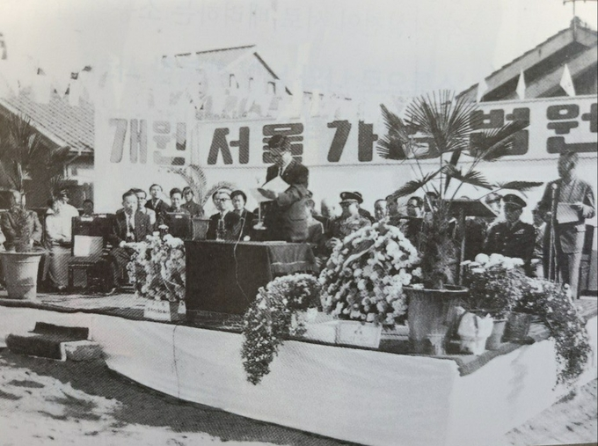
특례법 입법 경위와 목적
Opening Ceremony of the Seoul Family Court

Slide 5
특례법 입법 경위와 목적
﻿﻿2. Expansion and Development

Slide 6
특례법 입법 경위와 목적
﻿A. 1990 Civil Act Amendment
﻿The 1990 amendment eliminated many of the patriarchal systems remaining in the Civil Act. The amended law restructured the family system to be centered on individual members and more thoroughly implemented gender equality. Key changes included: ▶ Defining kinship equally through paternal and maternal lines up to the 8th degree. ▶ Abolishing most of the patriarch (hoju)'s legal powers. ▶Introducing the right to claim property division and visitation rights after divorce. ▶ Eliminating inheritance disparities between sons and daughters. In 1991, the Seoul Family Court issued its first ruling on property division under the amended Civil Act, recognizing a 50% contribution from a housewife to the marital property.

Slide 7
특례법 입법 경위와 목적
﻿B. 1990 Family Litigation Act
﻿To properly implement the revised Civil Act, the Family Litigation Act was enacted. Previously, family litigation was governed by the Civil Procedure Act, and non-litigious family cases by the Family Adjudication Act, leading to inconsistencies. The new Family Litigation Act unified these systems under one foundational law for family cases, abolishing the Family Adjudication Act.

Slide 8
특례법 입법 경위와 목적
﻿C. 1997 Introduction of
Domestic Protection Cases
﻿As domestic violence, particularly husbands abusing wives, became a serious social issue, the 'Act on Special Cases Concerning the Punishment of Domestic Violence Crimes' was enacted in 1997. It granted family courts jurisdiction over minor domestic violence cases. Unlike criminal cases, family courts focus on education, counseling, and therapy rather than punishment to restore relationships and prevent recurrences.

Slide 9
특례법 입법 경위와 목적
﻿D. 2001 Introduction of Family Investigators
﻿Family litigation requires knowledge in behavioral sciences such as social work, psychology, and education. Since most judges and court staff specialize in law, the family investigator system was introduced in 2001. These specialized court officials must have a master’s degree or higher in a behavioral science. This greatly improved the court’s professionalism.

Slide 10
특례법 입법 경위와 목적
﻿E. National Expansion of Family Courts
﻿Beginning in 2004, small family courts were established outside Seoul. Since 2011, full-fledged family courts have been opened. Currently, there are 8 family courts (in Seoul, Suwon, Incheon, Daejeon, Daegu, Busan, Ulsan, and Gwangju), with their branches offering services nationwide.

Slide 11
특례법 입법 경위와 목적
﻿F. 2014 Introduction of Child Protection Cases
﻿In response to increasing child abuse, the 'Act on Special Cases Concerning the Punishment of Child Abuse Crimes' was enacted in 2014. This gave family courts jurisdiction over minor child abuse cases. As with domestic violence, the emphasis is on education, counseling, and therapy, not punishment, to restore family functionality.

Slide 12
특례법 입법 경위와 목적
﻿﻿﻿3. Recent Trends and Challenges

Slide 13
특례법 입법 경위와 목적
﻿A. Child Support Guidelines
﻿To address regional inconsistencies in child support rulings, a standardized guideline was introduced in 2014 and is revised every 3–4 years, most recently in 2021. Though not legally binding, most courts follow it. ★ In the Child Support Guidelines Table, the horizontal axis represents the combined income of the parents, the vertical axis represents the age of the child, and the standard is based on two children. The minimum is approximately $450 (1,200,000MNT), and the maximum is approximately $2,130 (7,630,000MNT).

Slide 14
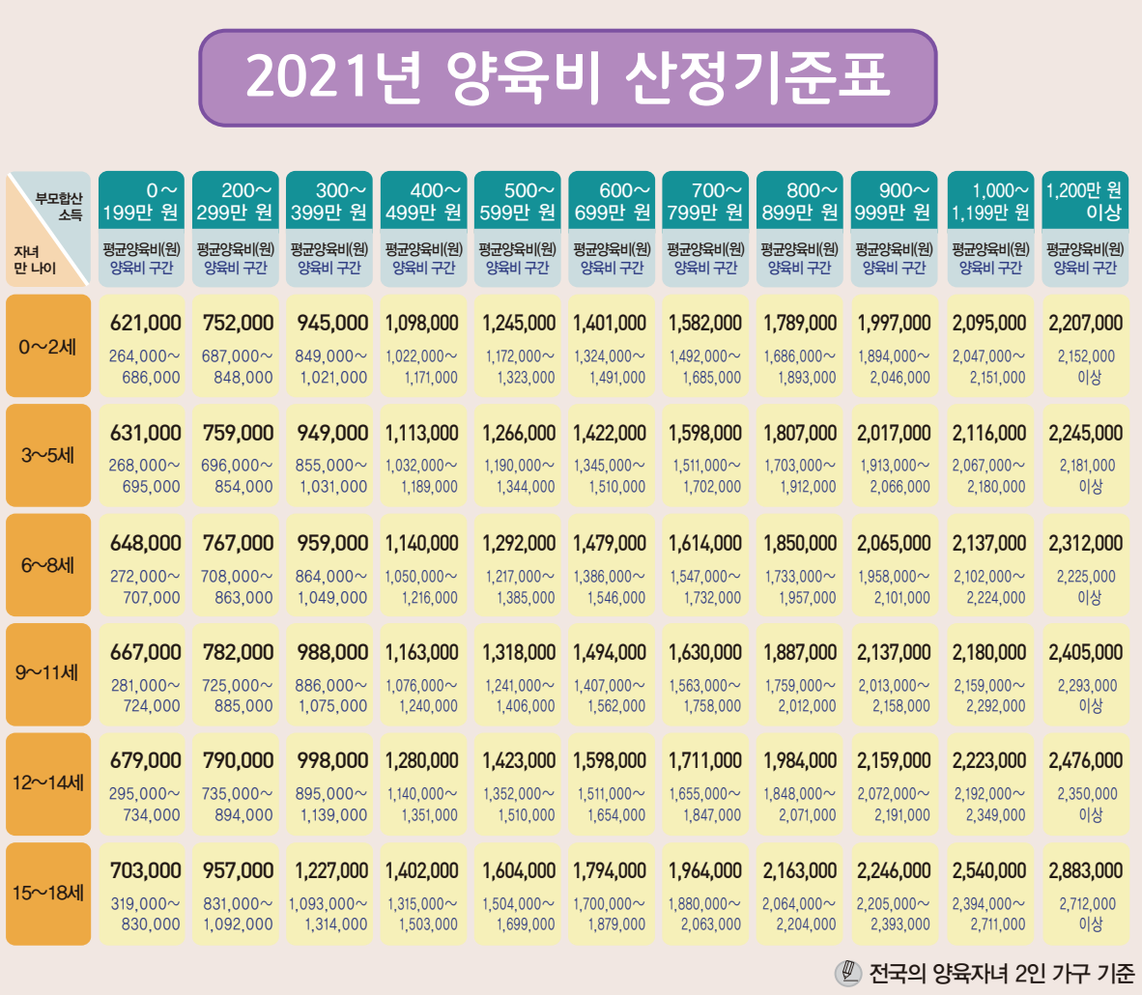
특례법 입법 경위와 목적

Slide 15
특례법 입법 경위와 목적
﻿B. Visitation Centers
﻿These centers help non-custodial parents meet their children post-divorce. The first was established in Seoul in 2014, and now most family courts have one. They aim to reduce parental conflict and maintain parent-child bonds, improving child welfare. Sufficient family investigators are essential to operate these centers. Due to rising demand, centers are being established outside of Seoul, including one in Guri in 2024.

Slide 16
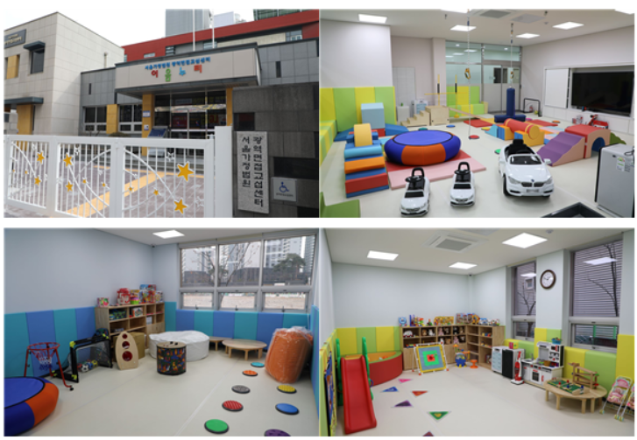
특례법 입법 경위와 목적
﻿Visitation Center in Guri

Slide 17
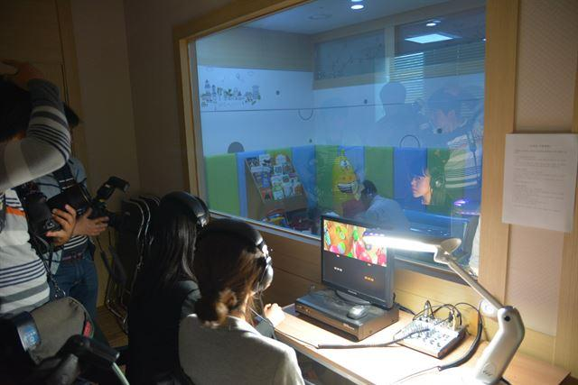
특례법 입법 경위와 목적
﻿One-Way Mirror Room (in Seoul)

Slide 18
특례법 입법 경위와 목적
﻿C. Increase in Family Investigators
﻿Currently, about 200 family investigators work nationwide—insufficient compared to Japan’s 1,600. Based on population﻿(Japan: 120 million; Korea: 50 million), Korea needs about 480 investigators—more than double the current number. The expansion of family court roles to include visitation support, protection for juveniles, domestic violence and abuse, and guardianship also necessitates more investigators.

Slide 19
특례법 입법 경위와 목적
﻿D. Expansion of the Therapeutic Role
of Family Courts
﻿Mental illness and addiction-related crimes are growing concerns. While Korea does not plan to establish separate drug courts, family courts have taken on this role to some extent. Juvenile, domestic, and child protection trials can mandate hospital-based treatment. However, the lack of treatment facilities is a major issue. Establishing national hospitals for juvenile offenders is under consideration.

Slide 20
특례법 입법 경위와 목적
﻿E. Preparing for a Super-Aged Society
﻿A super-aged society is one where more than 20% of the population is 65 or older. Korea entered this stage in December 2024. With over 800,000 elderly dementia patients, adult guardianship—where courts appoint guardians to manage finances and daily life—is becoming increasingly important. The demand for such cases is expected to surge. Courts are working to increase the number of judges and investigators and improve guardian training.

Slide 21
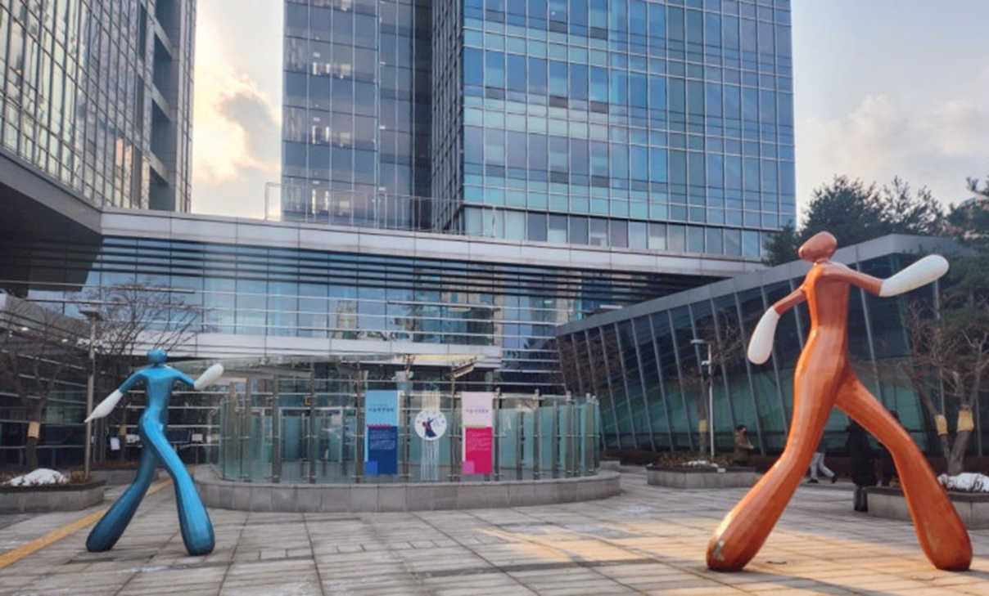
Thank you!

