Slide 1
Resolving Divorce and Custody Disputes in the Family Court of Japan
HARADA, Ayako
Professor, Nagoya University (Sociology of Law)
The International Conference on
“SPECIALIZED COURT: CHILDREN’S RIGHT AND FAMILY”
The Supreme Court of Mongolia, The Judicial Academy of Mongolia
Wednesday, 25 June 2025 Ulaanbaatar, Mongolia

Slide 2
Agenda
1. Overview of the family court of Japan
2. Procedures for divorce and custody
3. Family conciliation for custody cases
4. Listening to the voices of the children
5. Increased use of online proceedings
6. Facing new challenges

Slide 3
1. Overview of the family court of Japan

Slide 4
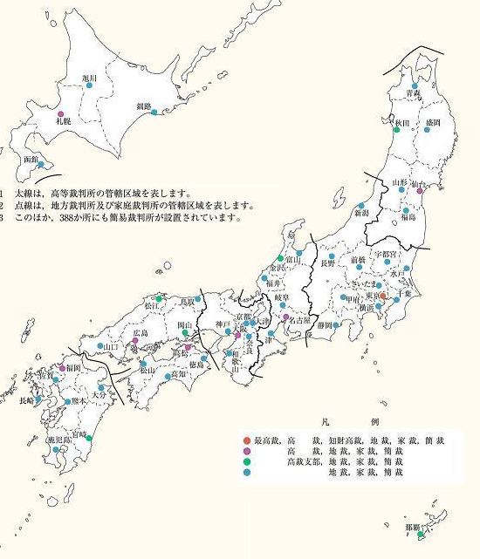
The Basics of the Family Court
-Established on 1 January 1949
-Goal: resolving family issues and rehabilitating juveniles.
“Peace for families, hope for children”
-There are 50 main family courts in all 47 prefectures (Hokkaido has four) with their 280 local branches.
In 2022, family courts received
-1,147,813 new family cases
-45,740 new juvenile cases
【Courts in Japan website 】
Notes:
Courts are located in pretty much all over the country

Slide 5
Why are ”Family and Juvenile cases” dealt with in one court?
Simply looking for facts that can be applied to laws is not enough to solve family and delinquency cases.
Understanding the human feelings, relationships, and environments behind disputes and delinquent behavior is essential for both family and juvenile cases.
Feelings
Relationships
Environments

Slide 6
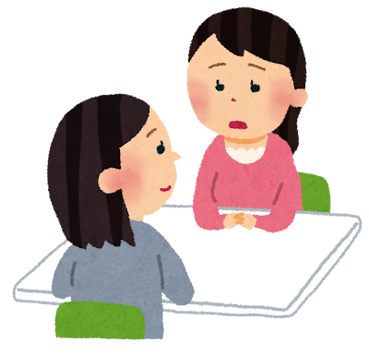
Family court investigators are behavioral science experts
Family court investigators, who are full-time court officials, are a unique feature of family courts. They:
Investigate facts through interviews with parties involved in domestic disputes
Meet children to hear their views in family cases.
Meet and talk to juveniles and their guardians in delinquency cases.
Visit schools and other information sources to gather information
Report the results of their investigations to the courts and parties and recommend specific solutions for family disputes or disposition for juvenile cases.

Slide 7
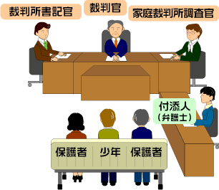
Juvenile Hearings
Judges:
examine the records sent by the police
hear the report and opinion of the family court investigator regarding the results of the investigation
hear the arguments of the juvenile, their guardians and their attendants (usually lawyers)
determine whether the juvenile has committed a delinquent act
If so, they determine what disposition is appropriate for their rehabilitation.
【Courts in Japan Website】
Notes:
The juvenile court hearing “shall be conducted in a friendly and conciliatory manner and shall encourage the delinquent juvenile to reflect on his or her own delinquency.”

Slide 8
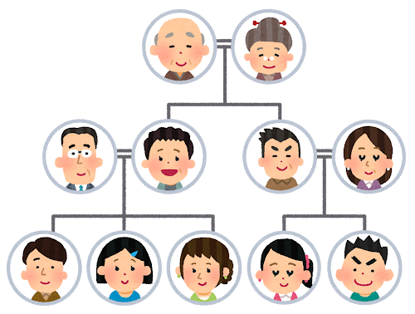
Family Cases (Domestic Relations Cases)
Family court jurisdiction
covers a wide variety of family issues, including,
Divorce, Parental authority and child custody,
Adoption, Child abuse, Paternity actions,
Guardianship for children, Guardianship for adults,
Distribution of inherited assets, etc.
Notes:
The purpose of the Juvenile Act:
To promote the healthy upbringing of juveniles, while correcting personality flaws and modifying the environment of delinquent juveniles through rehabilitation measures, and implementing special measures for juvenile criminal cases.

Slide 9
Types of family court procedures
Family conciliation（chotei）
An agreement is pursued through the court-annexed conciliation.
Not open to the public.
2. Family adjudication（shinpan)
Court decisions are made under the court's wide investigatory authority.
Not open to the public.
3. Personal status litigation (jinji sosho)
It is adversarial in nature, with some investigatory authority of the court.
Open to the public (with some protection of the privacy of litigants and witnesses)

Slide 10
Categories of family cases
“Table 1” cases: (negotiated solutions are not allowed)
Ex. Forfeiture of parental authority, appointment of a guardian, etc.
Only adjudication is available
“Table 2” cases: (negotiated solutions are allowed)
Ex. Child custody, distribution of inherited assets, etc.
Both conciliation and adjudication are available
If conciliation fails, the case is automatically referred to adjudication.
Personal status litigation cases:
Ex. Divorce, paternity action, etc.
Conciliation must be attempted before filing a lawsuit.

Slide 11
2. Procedures for divorce and child custody

Slide 12
Types of divorce
Divorce by Agreement (88.3% in 2020)
-Divorce can be completed only with the agreement of both spouses, regardless of whether they have assets or minor children.
Divorce by Conciliation (8.3%)
Divorce by Litigation (settlement 1.3%, judgement 0.9%)
It is adversarial in nature. Each party provides an argument and evidence.
Divorce grounds include adultery, violence, mental illness, not knowing whether the other party is alive or dead, and a serious reason that makes it difficult to continue the marriage.
Notes:
-Agreement of divorce and parental authority,
paper work submitted at city hall, no court involvement
-If no agreement of divorce, a party need to got to family court to have conciliation with the other party (mandatory divorce conciliation).
-Family courts provide family conciliation services to deal with divorce and related issues
-When conciliation make no agreement, parties can move to the divorce litigation

Slide 13
Divorce and children
Sixty per cent of divorces involve one or more minor children.
Under the current Civil Code, when parents divorce, one parent gains parental authority and the other loses it.
Parental authority: The rights and responsibilities for the care and education of children (equivalent to “custody” in other countries).
Upon divorce, parents can agree on the details of childcare issues, such as visitation and child maintenance payments.
If they cannot agree, the courts decide on parental authority, visitation, child support, etc.

Slide 14
Parenting arrangement after divorce
Mothers usually have parental authority over all their minor children.
(86.6% of divorces involving children in 2023).
Fathers tend to lose parental authority in divorce.
The bleak reality of parent-child visitation and child support after divorce is as follows:
Among post-divorce single-parent families, only 30% have visitation arrangements with parents who live separately.
Child support payment from divorced fathers is 'never received' in 56.9% of cases, 'have received' in 14.2% of cases and 'currently receiving' in only 28.1% of cases.
☛ Nationwide survey on single-parent households (2021).

Slide 15
3. Family conciliation for custody cases

Slide 16
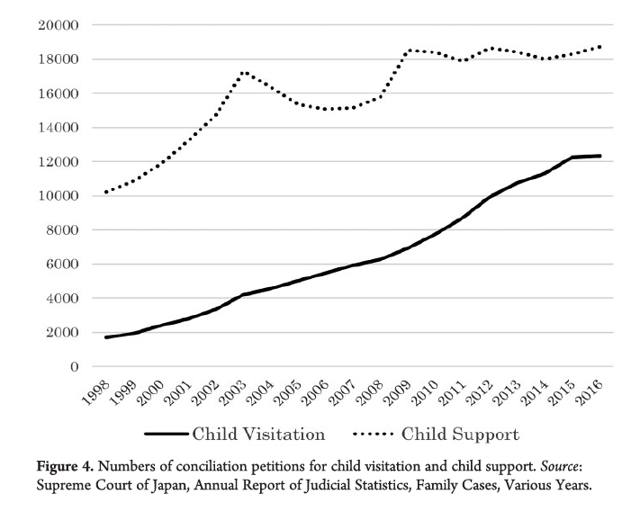
Increase in the Legal Disputes over
Child Custody
Since the 1990s, court disputes over child visitation and child support have sharply increased.
Notes:
Structural issues of gender-based violence at home and social relations is gradually recognized in Japanese society
Parents are getting critical to ’ right consciousness and sense of unfairness rose due to increased access to the information about other countries’ divorce law and practice that seem more “fair” than Japanese practice.
Japan ranked 120th among 156 countries in the gender gap rankings in 2021, remaining in last place among major advanced economies, a Swiss-based think tank said Wednesday.
Japan inched up one place from 121st in 2019, when the ranking was based on 153 countries, but stood far behind Italy, the next worst-ranked member of the Group of Seven industrialized countries, in 63rd place. The World Economic Forum said the level of women's participation in the political and economic arenas remains low in Japan.
Sharing house and child care work between moms and dads is quite immature in Japan. due to the social expectation for men’s full-commitment to work and lower economic status of mothers (Japan ranks 120th in gender gap index, lowest among G7.)
Family courts have to take the responsibility of dispute resolution as the “last resort” more often than before.

Slide 17
Background of the increase in custody disputes
The lack of visitation or support payments was a long-standing social practice, but many parents now feel it is unfair.
Legal claims are fueled by personal interests in relationships and money, as well as by a growing consciousness of gender equality.
There is a challenge to the regular practice of "one parent (usually the mother) taking all responsibilities over children.”
There is a new focus on the involvement of non-resident parents (mostly fathers) in their children's lives.
This new focus on non-resident parents' involvement with their children's lives is also leading to the recognition of the family violence issues and the need for victim protection in and after the process of divorce.
Notes:
Structural issues of gender-based violence at home and social relations is gradually recognized in Japanese society
Parents are getting critical to ’ right consciousness and sense of unfairness rose due to increased access to the information about other countries’ divorce law and practice that seem more “fair” than Japanese practice.
Japan ranked 120th among 156 countries in the gender gap rankings in 2021, remaining in last place among major advanced economies, a Swiss-based think tank said Wednesday.
Japan inched up one place from 121st in 2019, when the ranking was based on 153 countries, but stood far behind Italy, the next worst-ranked member of the Group of Seven industrialized countries, in 63rd place. The World Economic Forum said the level of women's participation in the political and economic arenas remains low in Japan.
Sharing house and child care work between moms and dads is quite immature in Japan. due to the social expectation for men’s full-commitment to work and lower economic status of mothers (Japan ranks 120th in gender gap index, lowest among G7.)
Family courts have to take the responsibility of dispute resolution as the “last resort” more often than before.

Slide 18
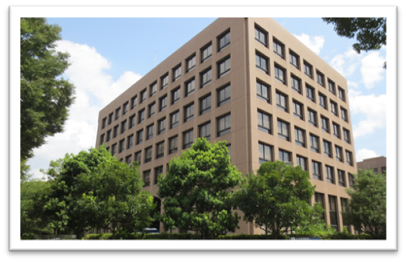
Feature of family conciliation
Family conciliation is available at all family courts
Conciliation is financially affordable.
Ex. Child custody conciliation costs 1,200 yen (=less than 10 euros.) per child for the whole process, that usually includes at least several sessions.
The Nagoya Family Court Building is home to both the Family Court and the Summary Court.【Courts in Japan Website】

Slide 19
Who are conciliators
A Conciliation Panel is formed for each conciliation case.
It consists of a family court judge and two conciliators, one male and one female.
Conciliators are part-time court officials who receive some compensation.
They are paid very little and are considered respected community volunteers.
They must be between 40 and 70 years old, and 70% of them are in their 60s.
90% are non-professional, local laypeople.
Notes:
-40 % are currently without jobs (housewives and retired people)

Slide 20
How the conciliation works
Conciliation Sessions: Not one-shot; usually takes 5-6 sessions.
Held once a month and continues for an average of 7.0 months.
Conciliators are always present at sessions, but judges are not.
Judges instruct conciliators in chambers.
Shuttle sessions are the regular practice. (Meeting one party at a time.)
A conciliation agreement has the same effect as a final and binding judicial decision.
In 2022, 46.3% of family conciliations ended in an agreement.19.8% had no agreement and 17.5% withdrew the petition.
Notes:
調停の成立率はどのくらい？
-Conciliation agreement has the same effect as a final and binding judicial decision.
-If custody conciliation fails, custody matters are referred automatically to the adjudication process.
成立が46.3％、不成立が19.8％、取下 げが17.5％を占めている（表７）

Slide 21
The efforts of family courts in solving child custody case
More frequent appointment of family court investigators
Regular use of the Child Support Calculation Guideline.
Educational guidance for parents during divorce conciliation
Despite their continuous efforts,
Family courts are facing strong criticism.
Notes:
‘Visitation once a month or less without an
overnight stay’
is the most common result.
本 的考え方・考慮 要素 Ｅ：具体的な算 定金額の例 ●算定基準表又は 養育費計算機による ●義務者の年収は 約300万円と想定 Ｆ：その他 （収入資料の入 手方法等） ・裁判官の共同研究の成果 との位置付け（直近は2019 年版） ・あくまで養育費算定のた めの目安だが，実務で定着 し活用されている ・民法766条1項において 「子の利益を最も優先して 考慮」と規定するのみ ・両親双方の収入と子の年 齢，人数を考慮して養育費 額を算定 ・義務者の収入のうち，仮 に子が義務者と同居してい た場合にその子のために費 やされた金額の程度を計算 し，その金額を，権利者・義 務者の

Slide 22
Criticisms to the Family Courts
Criticism #1: Difficulty making an amicable agreement.
High-conflict parties are difficult to compromise with. Visitation arrangements are more difficult to achieve than child support.
Criticism #2: Weak enforcement.
Visitation and child support agreements are difficult to enforce due to the lack of an effective enforcement or collection system.
Criticism #3: Violence and danger are not taken seriously. Victims and their children may be forced into unsafe contact with perpetrators.
Notes:
Approximately one-third of divorcing
parents leave court without any agreement on child visitation.
Only monetary sanction is available for the
lack of corporation to visitation.

Slide 23
4. Listening to the Voices of the Children

Slide 24
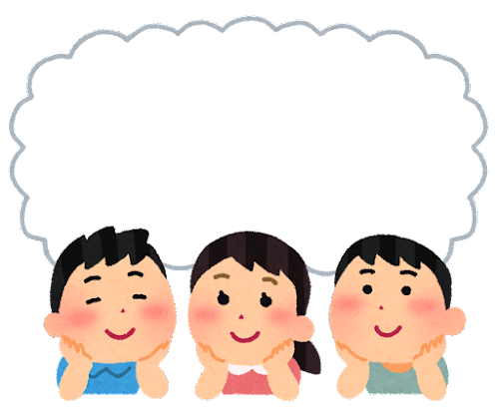


Global Trend Toward Child Participation
Japan ratified the Convention on the Rights of the Child (CRC) in 1994.
Since the adoption of the CRC, efforts have been made in the member States to reform the legal system to better protect the right of children to be heard (Article 12).
Countries need to make a transition to child-friendly court systems and ensuring children’s access to justice.
Examples of the international development in this area include..
: The Council of Europe’s Guidelines for Child-Inclusive Justice (2011).
:The United Nations Committee on the Rights of the Child's Draft General Comment No. 27, "Advancing Children's Rights to Access to Justice and Effective Remedies," adopted at its 95th session in Jan. 2024.

Slide 25
Expanding Opportunities for Children to Participate in Family Procedures in Japan
The Domestic Relations Procedure Act of 2011 requires family courts to consider the views of children in cases that affect them, taking into account their age and maturity (Art. 65).
The Act also stipulates that children over the age of 15 must be heard by the court in certain cases, including those involving custody, visitation, adoption, and parental authority, etc.
Notes:
T

Slide 26
How are children heard in family court?
Family courts have discretion: Through a report from family court investigators, or through a lawyer representing the child.
Although listening to a child through his or her parent is questionable due to possible conflicts of interest, it can be allowed in court practices.
Judges in Japan tend not to hear from children directly.

Slide 27
Family court investigators can interview children
They are trained to interview children.
They ask open-ended questions and do not force the child to choose one parent over the other.
They share the results of the child interview with the court and the parents.

Slide 28
However, investigators are not child advocates
The investigators' role as child’s advocate is limited.
Children are just one of the subjects of the investigation.
Lack of confidentiality
Usually only one interview
Limited feedback: Investigators cannot explain the results to the child later.
No access from the child: The child cannot contact the investigator later (to update what they want to say)
Notes:
They need neutrality as a family court official.
Their interview of a child usually occurs only one time.
No opportunity for the children to ask the investigator come again to talk to them.
No explanation to the child by the Investigator about the reaction of parents to the child’s feelings communicated by the investigator
No explanation to the child on the agreement/decisions at court.

Slide 29

Child advocacy by a lawyer for the child : A more promising approach
A lawyer may be appointed by the family court when a child participates as a party or interested third party in certain types of cases, including parental authority and custody cases.
Although participation of the child and the appointment of the lawyer is not yet common*, their emerging practices are highly child-participatory.
* In 2021, there were only 64 appointments (compared to more than 30,000 child custody cases.
Notes:
The family procedural law provides that:
Minor children generally lack the capacity to act individually in the family court proceedings.
But children can make a petition on their own in certain types of cases (ex. forfeiture of parental rights) specified in the law.
When they do so, they act as a party in the proceeding.
The court may also permit a child, as an interested third party, to participate in the proceeding for certain types of disputes, such as custody and visitation.
To be permitted to act as a party or an interested third party, children need to have capacity to understand their situation and make reasonable decision with expectations about future.
In practice, such capacity is considered to be attained around the age of 10, but it depends on the situation of each case/child
A lawyer for the child (child representative) may be appointed by the court as ex officio or by the child’s petition, when the child participates as a party or interested third party.
To be permitted to act as a party or an interested third party, children need to have capacity to understand their situation and make reasonable decision with expectations about future.
In practice, such capacity is considered to be attained around the age of 10, but it depends on the situation of each case/child
A lawyer for the child (child representative) may be appointed by the court as ex officio or by the child’s petition, when the child participates as a party or interested third party.

Slide 30
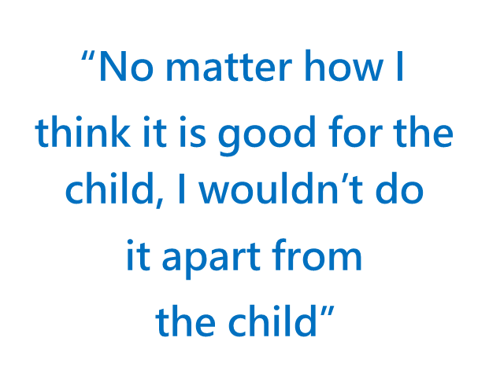
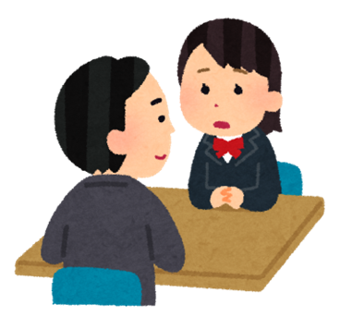
Child Advocacy by Children’s Lawyers
According to an interview research with 13 lawyers by Harada (2023)
The lawyers are supporting children in forming, developing, and communicating their views and wishes to influence the courts and their parents.
Notes:
-Lawyers focus on building a trusting relationship with the child through child-friendly and democratic communication styles.
-They try to assist children to express their innermost thoughts and feelings, and to accompany them in the process of sorting out their feelings and forming their own opinions.
-Lawyers also collaborate with the child to effectively communicate their views to the courts and the parents by the way the child wants.
-Feedback to the child about the court’s and parties’ reactions to the child’s views in the course of proceeding, as well as of the final result of the case.
-Many children who are listened to become empowered and energized.
-Parents become more child-centered and they reconsider their own attitudes and arguments, which has the effect of resolving conflicts.

Slide 31
Child Advocacy by Children’s Lawyers (Harada, 2023)
Lawyers focus on building trusting relationships with children by communicating with them in a child-friendly and democratic way.
They help children to express their innermost thoughts and feelings and support them in sorting out their feelings and forming their own opinions.
They also collaborate with the child to communicate their views effectively to the courts and parents in the way they want.
They provide the child with feedback about how the court and the other parties have reacted to their views throughout the proceedings, as well as the final outcome of the case.
Many children who are listened to feel empowered and energized.
Parents become more child-centered and reconsider their own attitudes and arguments, resolving conflicts in the process.

Slide 32
5. Increased use of online proceedings

Slide 33
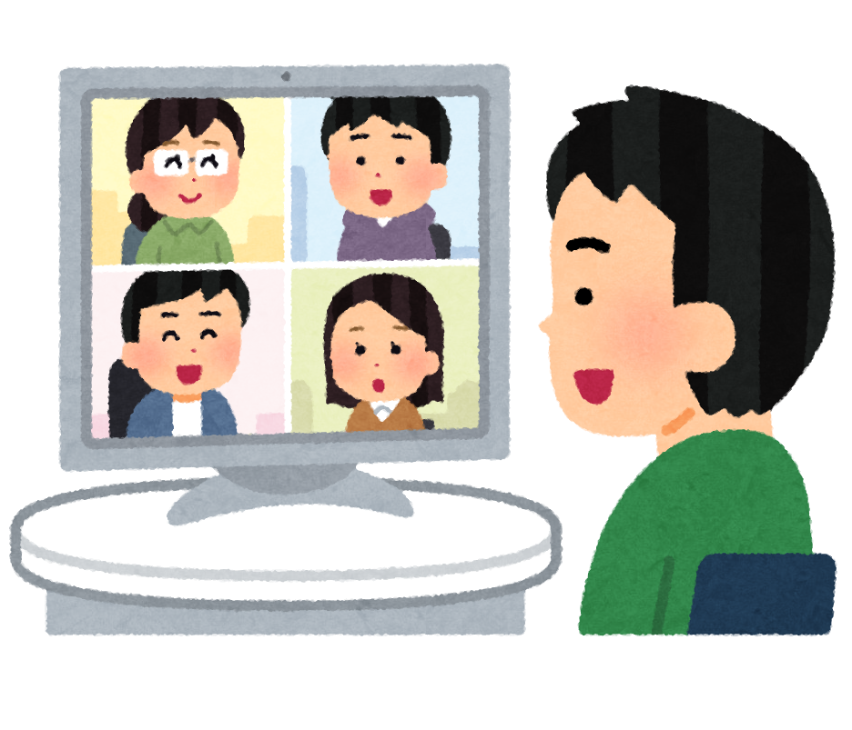
Digitalization and Online Family Proceedings
At the courts of Japan, online conference systems began being used around 2021 (The law allowed the use of it).
With the new procedural rules of 2023, all court procedures for civil cases, including family cases, will be able to be conducted online starting in 2026.
Family court judges have become more willing to hold online proceedings.

Slide 34
Pros Cons
Accessibility
-Distance -health condition
-Conflict of schedule
-Care of family members
-Work
Safety
- Don’t meet with the other party
In-person meetings may be better in
-Trust and rapport building
-Non-verbal communication
Logistics concerns:
-Some lack digital environment/ skills
Concerns about privacy and secrecy
-There may be other people nearby
Need to explore:
-A balanced combination of face-to-face and online sessions

Slide 35
6. Facing new challenges

Slide 36
The Revision of the Civil Code will take effect in May 2026.
Revision of Civil Code 2024
After divorce
Single Parental Authority
Single Parental Authority only or Shared Parental Authority
Wider Options for Parenting
Arrangement
Although legal options are widened,
Having various options does not solve parenting conflicts.
Or in fact, it may even increase the conflicts between parents.
Notes:
Contents: Japan has only had sole custody. Only one person can have parental authority. Until 1965, fathers often had custody, but mothers increasingly became parents. Gender norms are based on the idea that childcare is a woman's responsibility. Single-mother households are becoming more common as a result of divorce. Since the 1990s, the limitations of the sole custodial parent model have been recognized. ・Increase in the number of fathers interested in raising their children, increase in visitation request cases ・Poverty among single mother households became evident, partially because of the lack of child support payments.→Effective visitation and child support became a social issue and took political attention.
Arguments are being made that sole custody is obstructing the duties of post-divorce parents and demands for joint custody grew stronger than before. Expected 2024 Civil Code amendment will include post-divorce joint custody option for the first time in history. However, even if joint custody becomes an option

Slide 37
What is necessary to find better solutions for children?
-Increase family court resources.
This will help deal with the possible increase in custody cases.
There should be no delay for child cases.
-Develop social infrastructure and systemic collaboration
Education and consultation for divorcing parents, Domestic violence support,
Visitation support, Mental health support, etc. should be provided in the community.
Courts need to collaborate more with social services for families and children.
-Effective child advocacy and child participation
Respect children’s autonomy and their opinions on their parenting arrangement.
Family court should become more child-friendly and facilitate children's access to justice.

Slide 38
Thank you for listening!

Slide 39
References
Courts in Japan Website, https://www.courts.go.jp/index.html
Harada, A. (2019) “Family Reorganization in the Japanese Family Conciliation System: Resolving Divorce Disputes Involving Minor Children,” International Journal of Law, Policy and the Family, 33(1), 75-103. https://doi.org/10.1093/lawfam/eby019
Harada, A. (2021) “Child Custody Disputes in Japan: A Cultural and Institutional Perspective” Japanese Studies Association of Australia (JSAA) 2021 Conference, The University of Queensland and online. October 1 , 2021.
https://www.researchgate.net/publication/367125508_Child_Custody_Disputes_in_Japan_A_Cultural_and_Institutional_Perspective
Harada, A. (2023) “How can lawyers contribute to the children’s rights to be heard? Emerging practices of the Children’s Representatives in Japanese family court proceedings” International Society of Family Law World Conference 2023.7.14, Antwerp, Belgium. https://www.researchgate.net/publication/372346144_How_can_lawyers_contribute_to_the_children's_rights_to_be_heard_Emerging_practices_of_the_Children's_Representatives_in_Japanese_family_court_proceedings
Harada, A. (2023) Protection of the Children’s Right to Be Heard: Children’s Rights in the Family Justice System. Shinzansha Publisher Co., Ltd.

Slide 40
Liefaard, T. (2019) “Access to Justice for Children: Towards a Specific Research and Implementation Agenda” The International Journal of Children's Rights, 27(2), 195-227. https://doi.org/10.1163/15718182-02702002
Ministry of Health, Labour and Welfare, Japan. (2021) Nationwide Survey on Single Parent Household (2021). https://warp.da.ndl.go.jp/info:ndljp/pid/12862028/www.mhlw.go.jp/stf/seisakunitsuite/bunya/0000188147_00013.html
Ministry of Health, Labour and Welfare, Japan. (2022) Overview of the Divorce Statistics, 2020, https://www.mhlw.go.jp/toukei/saikin/hw/jinkou/tokusyu/rikon22/dl/suii.pdf
Schrama W, Freeman M, Taylor N, Bruning M, eds. (2021) International Handbook on Child Participation in Family Law. Intersentia.
Supreme Court of Japan, The Guide to the Family Courts of Japan, 2023. https://www.courts.go.jp/english/vc-files/courts-en/Material/Guide_to_the_Family_Court_of_Japan_2023.pdf
The United Nations Committee of the Rights of the Child. (2024) Draft general comment No. 27 on children’s right to access to justice and to an effective remedy, 1 February 2024, CRC/C/GC/27, https://www.ohchr.org/en/documents/general-comments-and-recommendations/draft-general-comment-no-27-childrens-right-access

