Slide 1
The Mental Health of Family Court Judges
Managing empathy and regulating emotion
“SPECIALIZED COURT: CHILDREN’S RIGHT AND FAMILY”
International Conference, Ulaanbaatar, Mongolia
25 June 2025
Carly Schrever and Sally Ryan
Psychologists; Directors, Human Ethos

Slide 2
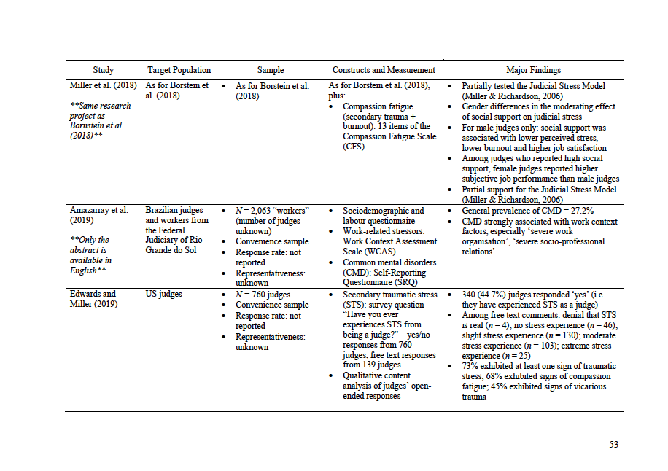
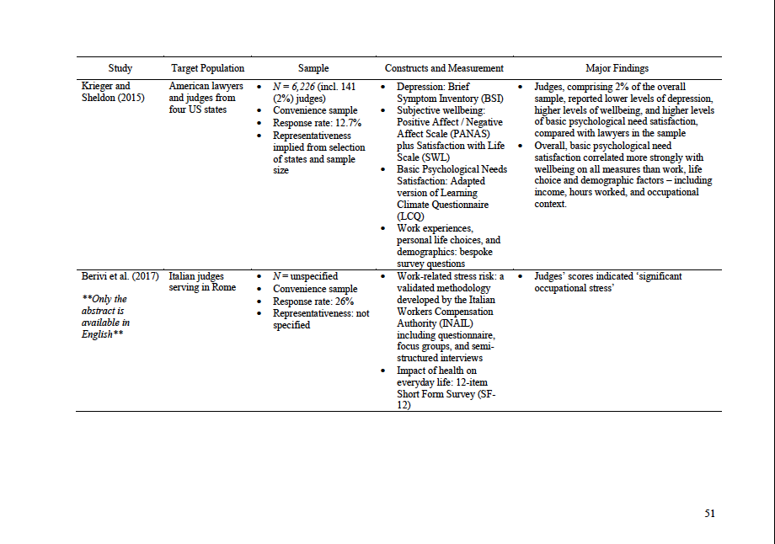
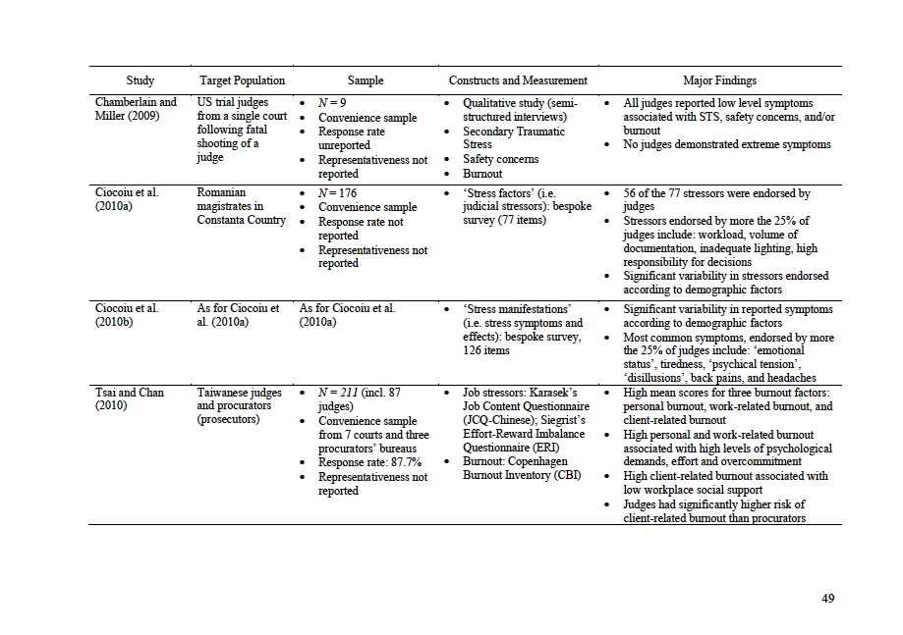
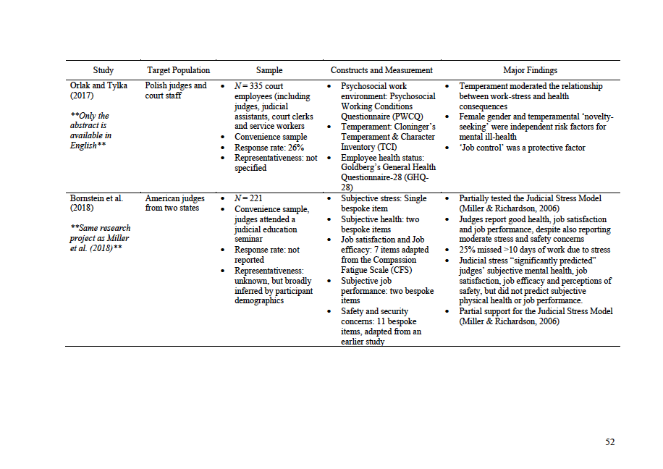
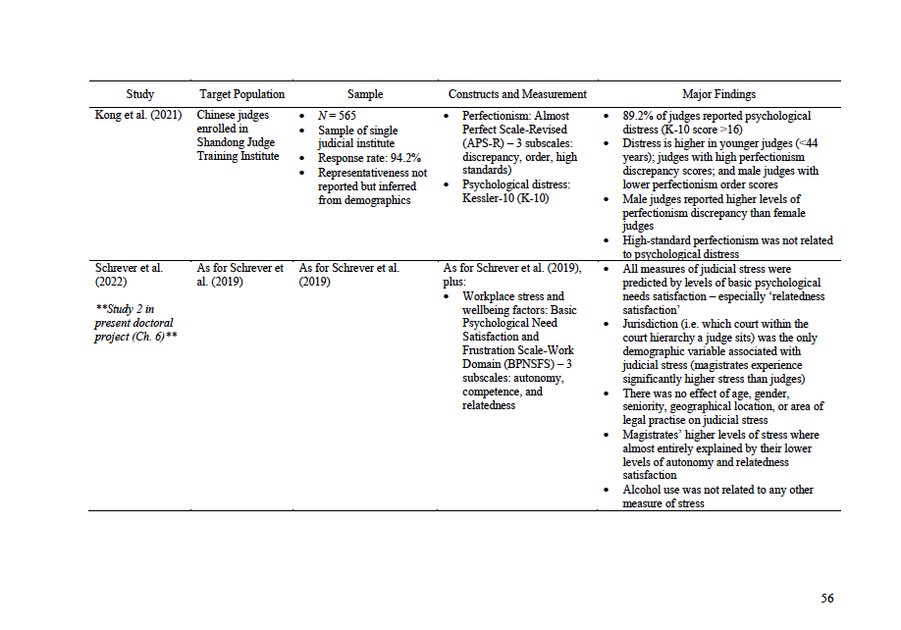
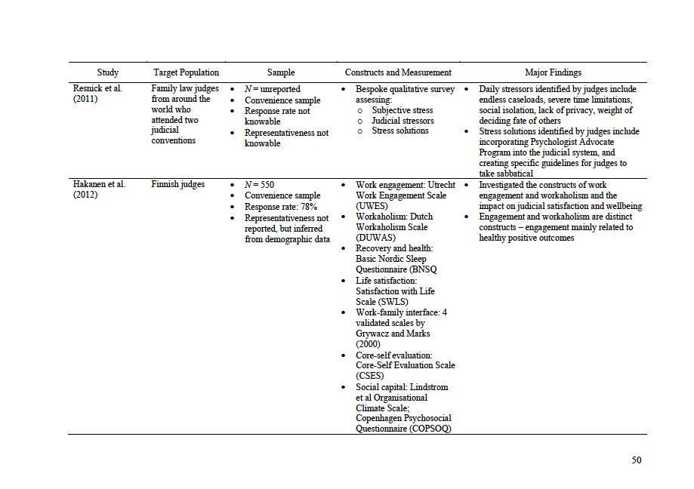
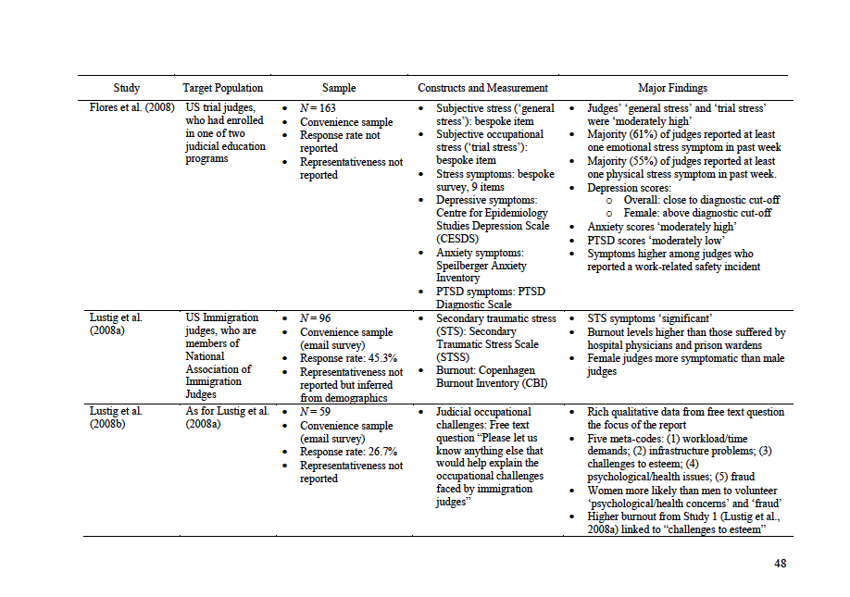
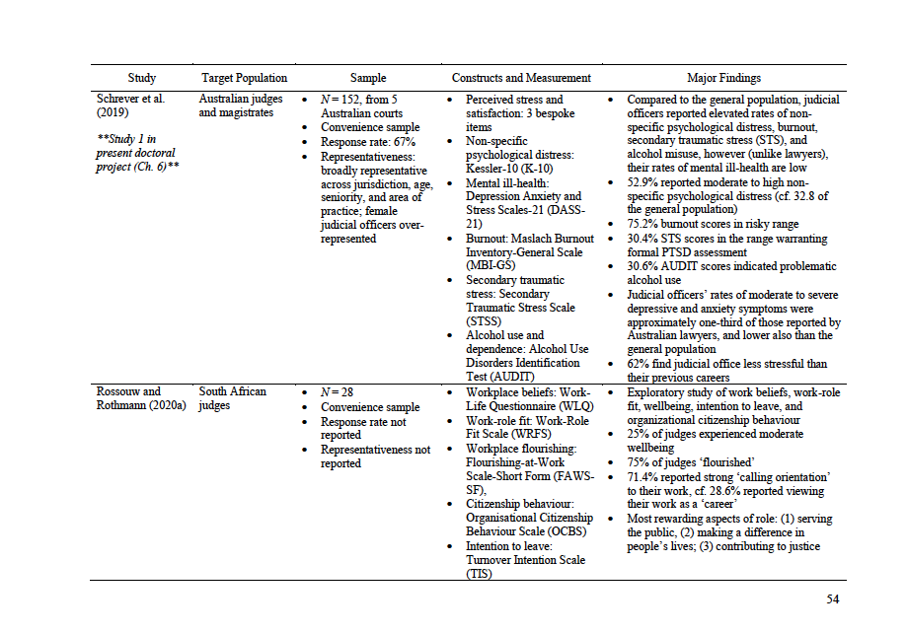
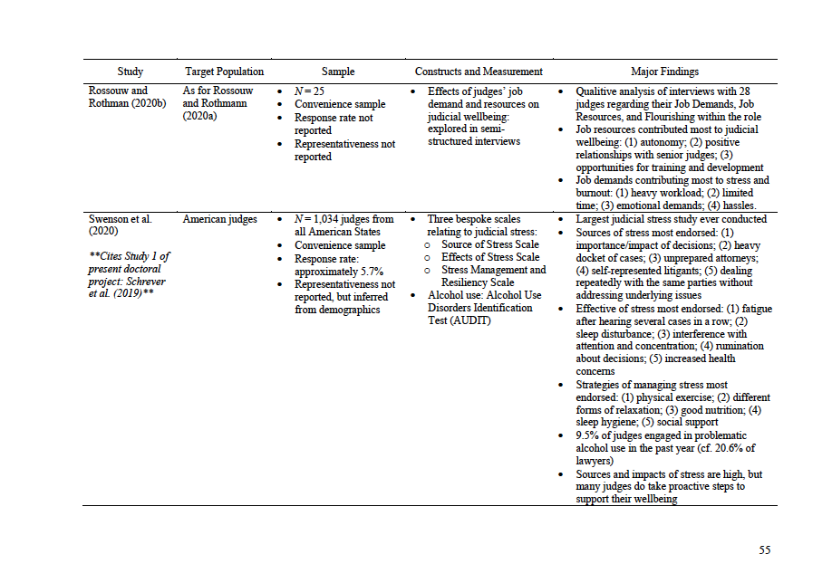
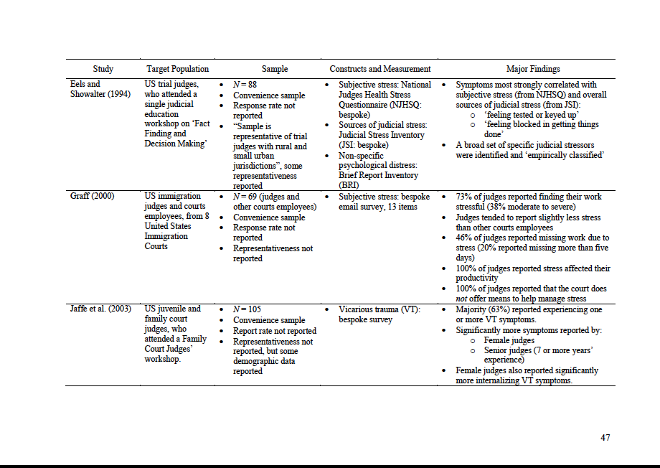
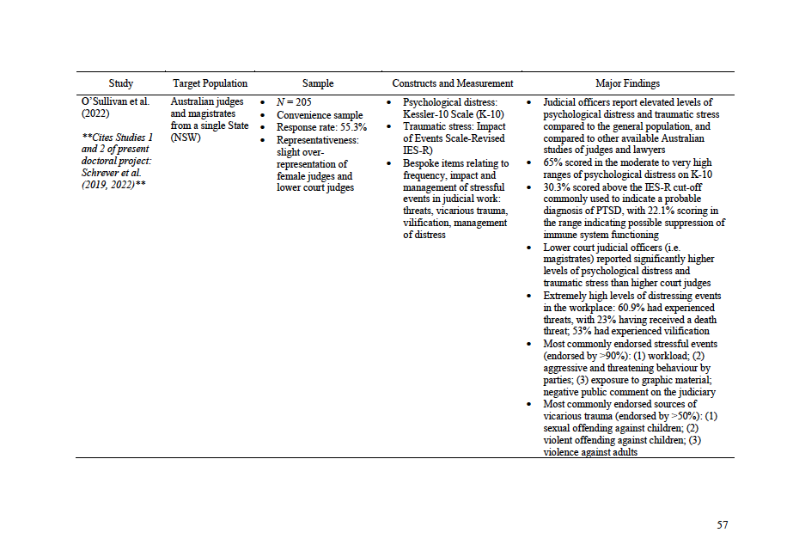
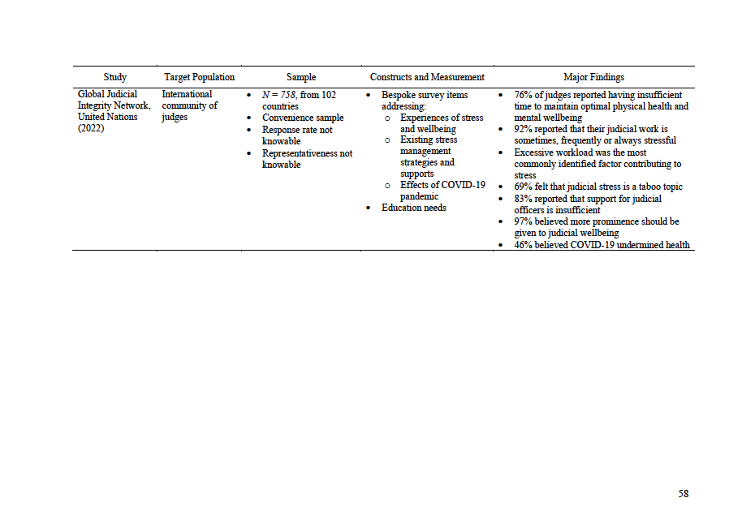
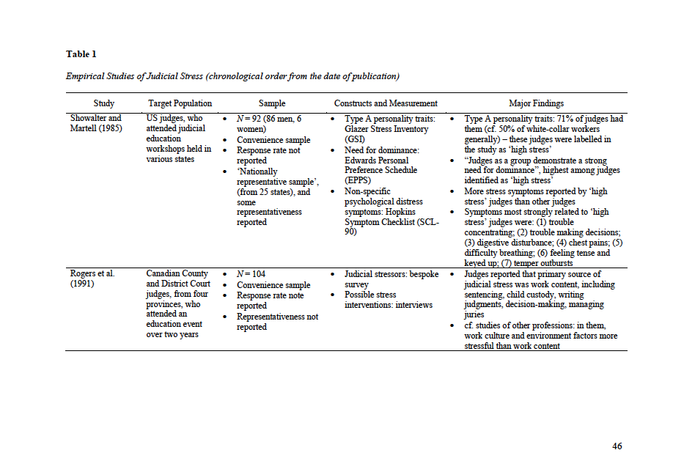
Empirical research on judicial stress and wellbeing
Schrever (2023), Ch 4
Notes:
Literature review for my PhD submitted in December 2023 – 29 empirical studies in total
Selected only studies that set out to empirically focus in judicial stress and/or wellbeing – not those that briefly touched on stress while focusing on other things
May have missed some – especially if not published in English – PLEASE TELL ME!
Increased in frequency and scientific rigour over time
Only 14 when I commenced the PhD, 8 from the US, and only 6 employed validated stress measurement techniques
Now studies from every continents, many using validated measurement instruments enabling comparisons with other jursidictions, the legal profession, and the general population.
Several from Europe
2 from Romania
Finland (large scale, rigourous)
Italy
Poland
Aware of other more recent studies, including one from the Netherlands and one from Portugal

Slide 3
Judges report finding family law cases and cases involving the distress, mistreatment or abuse of children to be the most stressful

Slide 4
Empathy-based stress

Slide 5
What is empathy-based stress?
EMPATHY-BASED STRESS REACTIONS
VICARIOUS
TRAUMA
SECONDARY TRAUMATIC STRESS
COMPASSION FATIGUE
BURNOUT
Disruptions to a person’s beliefs about safety, power, independence, esteem, intimacy, and/or frame of reference as a result of being exposed to another’s traumatic experiences
Development of PTSD symptoms
(re-experiencing, arousal, avoidance, emotional numbness) following the traumatic experience of an important person
Reduction in the capacity or interest in being empathetic towards others, believed to result from ongoing expenditure of empathy
Presence of emotional exhaustion, cynicism, and feelings of disconnection from others, resulting from prolonged work and interpersonal demands
Notes:
Firstly it’s important to be clear on what we are talking about – what is vicarious trauma
VT is one of several terms used to describe empathy-base stress reactions
VT, STS, compassion fatigue, burnout
Until recently, none of these were considered diagnosable mental disorders under the DSM (now STS is a pathway to PTSD)
Boundaries between them very blurred
They are simply terms that have emerged to describe very similar things – i.e. the psychological distress that people can experience following exposure to and empathic engagement with information about the trauma suffered by another
With those caveats, we can loosely define Vicarious Trauma as… CLICK
See how each are related, and but also how they differ.
Very serious experiences we are talking about here – with the capacity to dramatically alter a person’s personal and professional functioning and enjoyment of list

Slide 6
How empathy-based stress works
Contextual Factors
(e.g. emotional display norms, form / frequency of trauma exposure, support)
Adverse Occupational Health & Wellbeing Outcomes
(e.g. burnout, depression, anxiety, health)
Negative Work Affect, Behaviours, & Cognitions
(e.g. performance, turnover, satisfaction, absenteeism)
Empathy-Based Stress
(i.e. compassion fatigue, secondary traumatic stress, vicarious traumatization)
Secondary Trauma Exposure
&
Empathic Engagement
Individual Factors
(e.g. demographics, individual differences, personality, coping style)
Rauvola et al (2019), Compassion fatigue, secondary traumatic stress and vicarious traumatization: A qualitative review and research agenda, Occupational Health Science, 3, 297-336.
Notes:
As I say, these are considered empathy-based stress-reactions, because empathy plays a key role in exposing us to these experiences.
Here is how it works:
We start with features of our environment and features of our own history, personality and coping style
They come together to determine both the extent of the secondary trauma we are exposed to AND the level of empathic engagement we have with that secondary trauma
When there is high exposure and high empathic engagement, this can lead to empathy-based strain, in the form of compassion fatigue, secondary traumatic stress and vicarious trauma
If have insufficient time, resources and support to recover from this strain, it can lead to adverse outcome for our health, including mental health, and for our work.
So you can see that it is actually Empathy - that personal quality that makes us most human and that we need to do our work with meaning and purpose – that makes us ALL vulnerable to vicarious trauma.

Slide 7
Traumatic stress and judicial work
Cumulative impact of traumatic material and environments;
Often triggered by a detail of personal relevance or significance;
Disruptions to beliefs about the world… and the justice system
“Each day you go into Court and there’s sadness… there’s extreme sadness, and there’s damage. And it’s people struggling to have their rights protected who are damaged. And I feel very sad… You don’t bring it into the Court room with you, but you feel it.” (Judge)
Notes:
I am sure it is not hard to see how these experiences might be occupational hazards for lawyers and and legal support staff – like yourselves – who work within the areas of personal injuries, institutional liabilities and medical negligence.
Lawyers and those that support them confront, on an almost daily basis, the worst of human misery and suffering
At their most benign, legal disputes deal with very expensive accidents and irreconcilable disagreements
At their most horrific, they deal with the very worst that humanity does to itself
Lawyers doing the kind of work that you do have to digest information about tragedy, injustice and abuse, and witness people who are traumatized and frightened – and then synthesize that information in order to run cases that significantly impact people’s lives.
Prolonged exposure to distressing subject matter and working with or opposed to people in distress can have a gradual cumulative impact – particularly when there are insufficient time and resources for regular recovery and integration of that material.
But even though the cumulative impact occurs gradually, the experience can sneak up on us.
People in a range of occupational settings that are exposed to trauma – and I am thinking in particular here about police and first responders – often say that they can do their work for a long time – years even – without feeling impacted and without registering the cumulative exposure, but then there will be a case that triggers a reaction. Usually it is a se with some element of personal significance
VT disrupts core beliefs that make us feel safe and able to function
Lawyers and court workers put faith in the system – but sometimes the system doesn’t deliver justice
And given, connection to meaning and purpose is one of the ways we can protect ourselves from VT, losing our faith in the justice system to deliver on it’s promise can become a vicious cycle

Slide 8
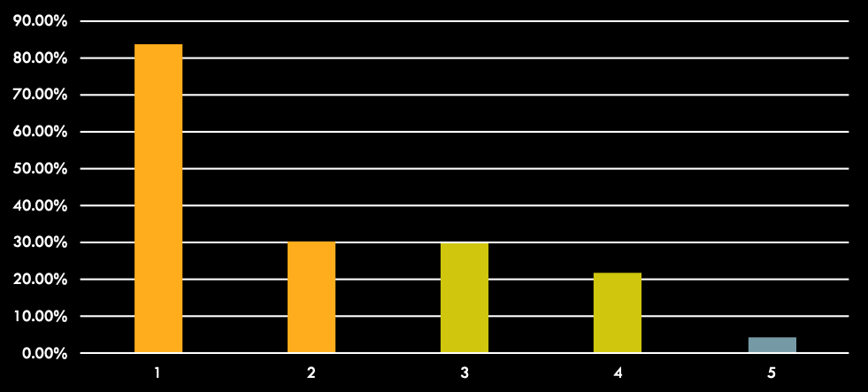
Traumatic stress and the judiciary
12 month population prevalence of PTSD in Australia is 5.7% (2.3-6% in the US)
Schrever Study:
83.6% of judicial officers reported at least 1 symptom of secondary traumatic stress
30.4% scored above the cut-off warranting PTSD assessment (Schrever et al, 2019)
NSW Study:
30% of NSW judicial officers’ scores suggested PTSD diagnosis
22% scores suggested possible suppression of immune system functioning (Hunter et al, 2021)
Notes:
Victorian study
In the 1 week prior to the survey:
83.6% of judicial officers reported at least one symptom of STS
30.4% scored above the cut-off warranting PTSD assessment
NSW Study
30% of judicial officers scored high enough to suggest probable diagnosis of PTSD
22% scored high enough to suggest possible suppression of immune system functioning
To put this perspective:
12 month population prevalence of PTSD in Australia = 4.4%

Slide 9
Empathy-based stress is an occupational hazard for judges
(especially in family law)
Notes:
What all this research amounts to is that VT is an occupational hazard for judicial officers – especially those working with cases tragedy, violence, neglect

Slide 10

“Now, there's two things that can happen to you. Either you're going to remain a decent person and become terribly upset by it all because your emotions, because your feelings, are being pricked by all of this constantly. Or you’re going to become – you're going to grow a skin on you as thick as a rhino, in which case I believe you're going to become an inadequate judicial officer because once you lose the human – the feeling for humanity you can't really – I don't believe you can do the job.”
Australian magistrate, quoted in Roach Anleu & Mack (2005), Magistrates everyday work and emotional labour, Journal of Law and Society

Slide 11
Holistic wellbeing strategies
Spiritual
Occupational
Mindfulness
Connection to meaning and purpose
Attend to and align with values
Consciously operate from ‘role’
Boundaries
Professional identity
Spiritual
Occupational
Emotional
Physical
Practice emotion regulation
Emotional granularity
Share difficult thoughts
and feelings
Diet (e.g. 5 serves vegies)
Sleep
Substances (e.g. alcohol)
Exercise (e.g. 10,000 steps)
Your
Wellbeing
Emotional
Physical
Social
Cognitive
Activities of pleasure and mastery
Nurture trusting relationships
Share thoughts and feelings
Social
Cognitive
Cultivate learning mindset
Tune into self-talk, especially perfectionism
Break down and prioritise tasks
Notes:
Stress can show up in each of these domains, and there are a large number of strategies and approaches within each of these domains that support wellbeing. When we have more time with individuals and workplaces, we have deep conversations about all six areas of wellbeiing

Slide 12
Emotion regulation
Shaping what you feel, when you feel it, and how you express it, in order to meet professional and personal expectations and goals.
Prof. Terry Maroney (2023)
Notes:
I tend to think of emotion regulation as about being aware of how you are feeling, being able to think about the feeling, being able to think about how to respond and responding with choice
Emotional regulation is not about feeling calm all the time
It is normal to experience negative feelings at home and at work
It is more about managing emotions in a healthy way

Slide 13
Categories of Strategies
EMOTION
MANAGEMENT
EMOTIONAL INTELLIGENCE
NOT HELPFUL
Repression and Denial
Representing to self and others that you don’t feel what you feel
‘mustn’t grumble’
‘push it down’
Masking what you feel
Emotional labour
‘Parking’ feelings
Noting feelings, but not expressing them
Managing emotion to get the job done
‘holding it together’
‘professional mask’
Processing emotions
Attending to emotions
Tolerating difficult emotions
Expressing emotions
Building emotional connection
Inquiring into our emotional reactions
Prof. Terry Maroney (2023)
Notes:
NOT HELPFUL – Repression and denial
doesn’t diminish emotion
ironic rebound & misdirection
impairs memory, cognition & judgment
can harden into repressive coping
NECESSARY EVIL
crucial to demeanor, controlling courtroom
little impact on emotion
some impairment of memory, increase in cognitive load
use purposely and sparingly
EMOTIONAL INTELLIFENCE
Processing emotions in an optimal and healthy way
Takes time and space – which we usually don’t have in the moment

Slide 14
In the moment
Ongoing
4-2-6 breathing
Anchor in place
Bilateral tapping
  Beetle wings
  Butterfly arms
  Toe squeezes
‘I am… my role is…’ mantra
Learn from experience
Practice emotional granularity
Share difficult thoughts and feelings
Find meaning in the difficulties
Notes:
Learn from experience
Build awareness of your triggers
Learn from experience
Reflect upon what is getting triggered (possibly with support)
Recognise when you are emotionally triggered it can be trauma response:
Body goes into fight-flight-freeze
Notice how this feels, try not to avoid
Breathe through it, ground yourself
Reflect and notice how you feel
Helps to gain control over the sensations
Practice emotional granularity
sometimes referred to as “emotional expertise”
A lot of research that people who have high emotional granularity also manage stress better and have better coping and mental health – e.g. is it angry, disappointed, resentful, or offended – or is the anger actually protective emotion, helping us to avoid feeling a more vulnerable emotion like shame or fear or sorrow?
Emotional granularity is considered a highly trainable skill
Share difficult thoughts and feelings
Language is the digestive juice of the psyche
Find meaning in the difficulties
Reconnect to the meaning and purpose of your role,
Values that drew you to this work
What is challenging is also often what is satisfying
Tonglen Practice
Our tendency – both biological and cultural – is to move away from difficult feelings – which creates many problems in our lives
The tonglen practice is a meditation practice to reverse that tendency and a particular meditation practice designed to help us build our capacity to tolerate and difficult emotions, and connect with the wider human experience.
It involves, once we have identified the difficult emotion we are feeling, breathing it in and allowing it to be felt
And then breathing out a hope or a wish or a prayer for every other person who is experiencing that emotion right now
Very powerful – can be done for one breath, 5 breaths, or as a full meditation practice for several minutes

Slide 15

Thank you
Carly Schrever & Sally Ryan
Psychologists
carly@humanethos.com.au | sally@humanethos.com.au
z

